Slide 1
LATE MODERNISM
MODRIAN-SPRIAL JETTY
2020

Slide 2
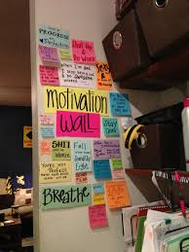
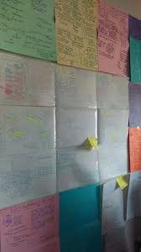
APAH EXAM=MAY 15 @ 12 OPEN BOOK & NOTES

Slide 3
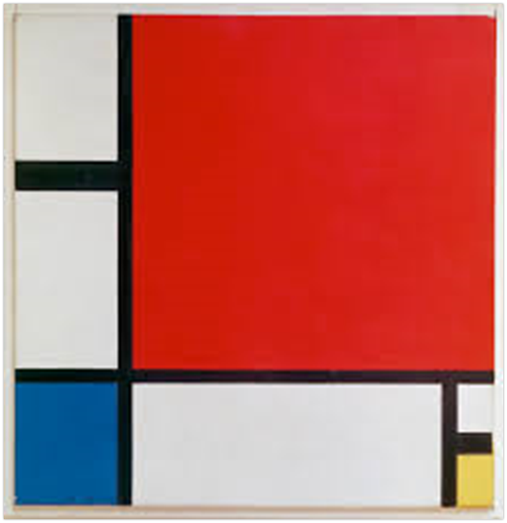
Composition With Red, Yellow and Blue
=Piet Mondrian
FORM: REDUCTIVE=Reduced to Line & Color
Minimalist & Uses No Ruler =Free Hand Drawing
Primary Color
Geometric Form
No Shading OR SYMETRY
SHOWCASES OPPOSITES/DUALITY=
BLACK/WHITE
MALE/FEMALE
NEGATIVE/POSITIVE SPACE
ASSYMETRICAL/SYMETRAL PLANES
FUNCTION:
INNOVATIVE & ABSTRACT
ARTIST NEW VISION OF ART & VISUAL WORLD

Slide 4
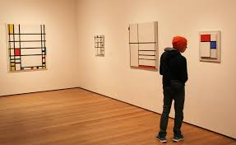
CONTEXT:
Reduced to the simplest of rectilinear forms, squares and rectangles defined by vertical and horizontal line
Utopian movement in The Netherlands =Construct Works
That communicate Spiritual Harmony
ILLUSTRATE UNIVERSAL HARMONY & ORDER
He believed that his paintings could assist a viewer in conceptualizing the spiritual realm, which, according to Theosophists, existed outside of time and space.
CONTENT:
1)Thick black lines=
VERTICAL LINES- Phallic/ Masculine
HORIZONTAL LINES-
FEMININE
2) Gridded black lines locking squares of color into a geometric composition,
3) Simple & Geometric
4)Utilize Large Blocks of Negative Space

Slide 5
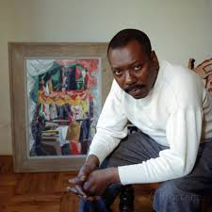
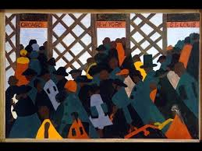
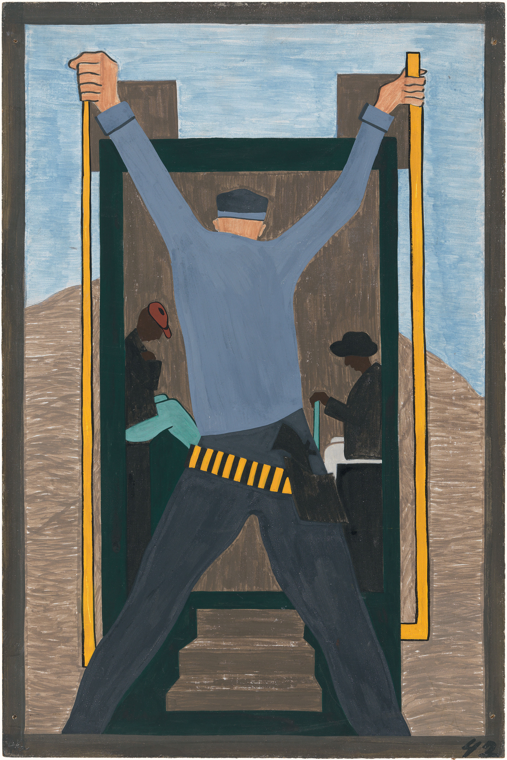
Jacob Lawrence-The Migration of the Negro #49 *Influenced by Matisse & Picasso *Depict Colors & Shapes of Positive & Negative American Black Experience * Illustrates the Great Migration of 6 million African Americans from the South to the North 1916-70.
C O N T E
X
T

Slide 6
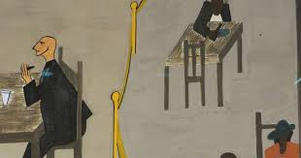
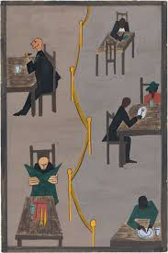
FUNCTION: Innovative & Experimental Illustrates Historical Narrative
Gargoyle like White Figures
Ignoring Black figures
Faceless/ Voiceless Black Figures=
Comments on Black Am Place in Society
FORM:
Flat
Angular & Distorted
Human Forms
Strong Diagonals
Primary Colors
Like Matisse= Tilted Tables & Perspective
Yellow Line= Bifurcated/ Divided Canvas
Contrasts of light and shadow contribute to the themes Segregation, Racism & Oppression
CONTENT:
1)Americans adapt European Modernism
2)Cubist tension of space & Jagged/Angular Shapes
3)Reductive= Reduces Image to Shape & Color
4) Abstracted Narrative of story of African American Migration North =Themes of Segregation & Racism

Slide 7
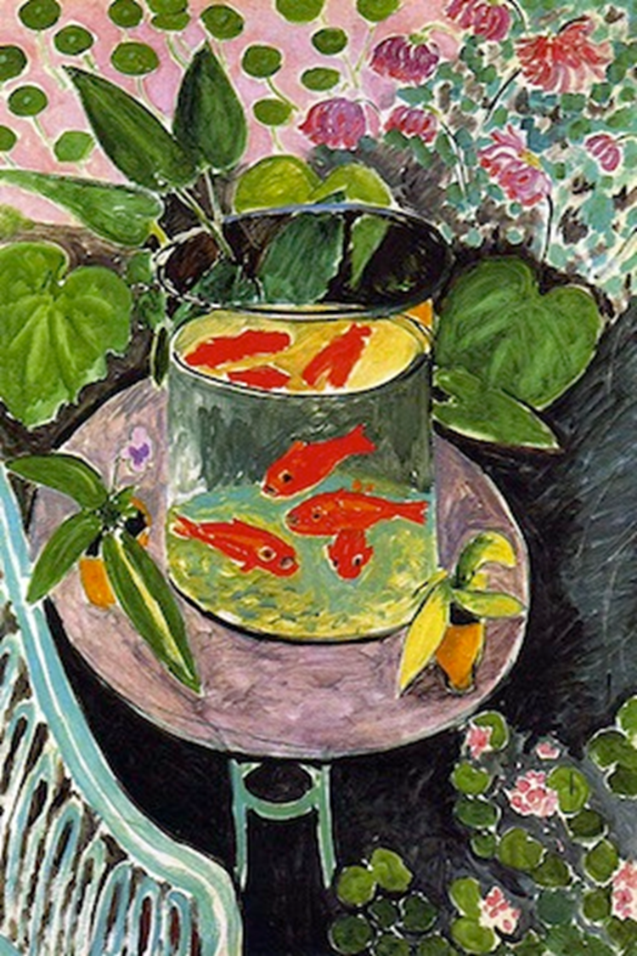
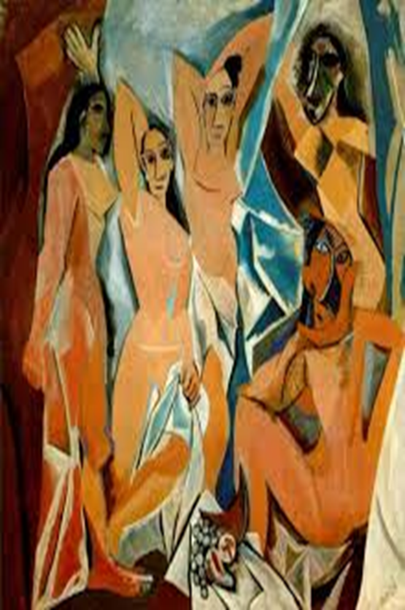
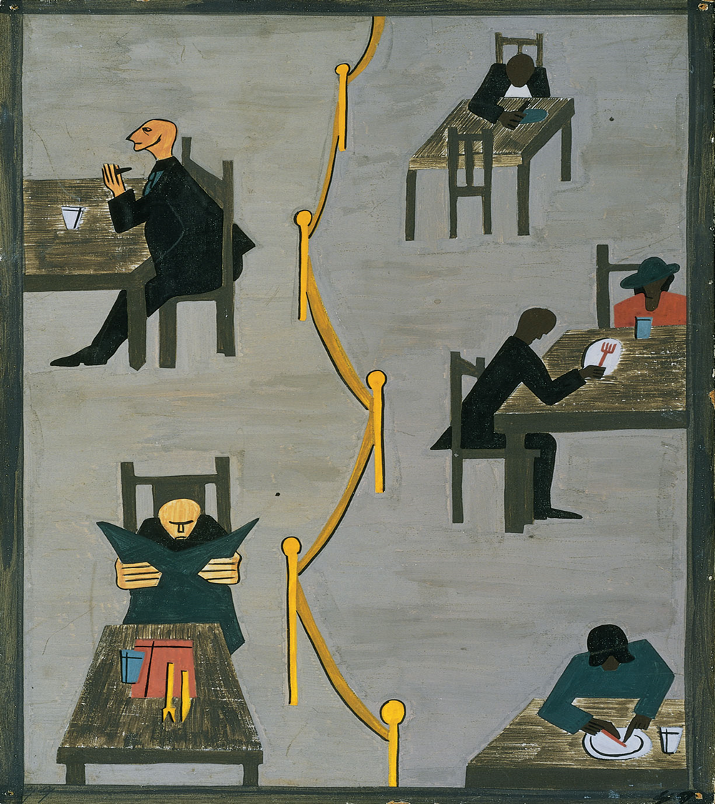
MODERN ART =
USES REDUCTIVE FORM
DISTORTS
PRESENTS MULTIPLE PERSPECTIVE
REJECTS TRADITION

Slide 8
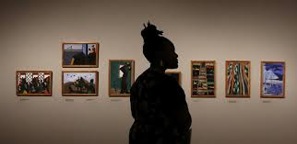
JACOB LAWRENCE #49 IS PART OF A SERIES OF 60 PAINTINGS

Slide 9
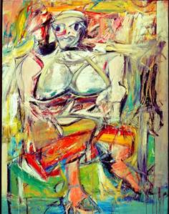
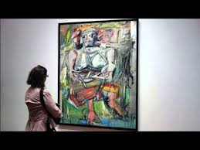
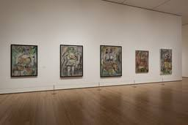
# 145 -Woman I William De Kooning Oil on Canvas- 6x4
FORM:
Distorted
Abstract
Slashing & Jagged
Black Lines
Vertical= Power
Asymmetrical
Part of a Series of 6
Huge=
Important Idea
FUNCTION:
Depiction of Female Form
Abstract Expressionism Painting-
aka The New York School
First AMERICAN ART Movement

Slide 10
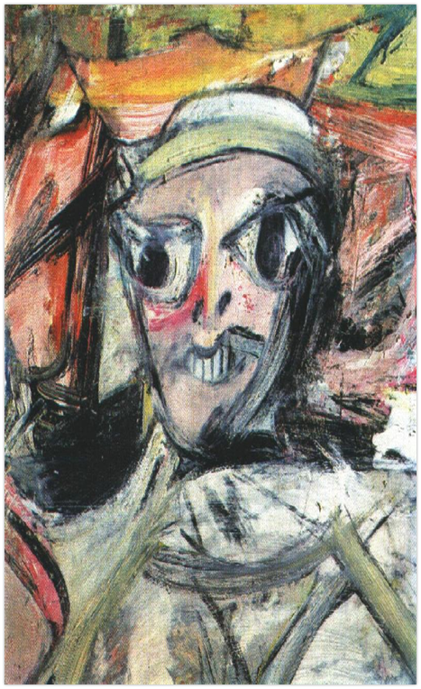
CONTEXT:
CONTENT:
1)Combination of Female Stereotypes=
Big Breast, Wide Eyes, White Teeth
& Small Feet
2)Seated Depiction of Woman= Madonna
= Made Profane
Aggressive, Sexualized ,Large, Distorted=like ADS
3)Ironic Comment on the BANAL &
ARTIFICIAL & Sexually Objectifying
World of Ads & Filmmaking
4) Jagged & Angry Black Lines
depicted a Distorted & Abstract Female Form

Slide 11
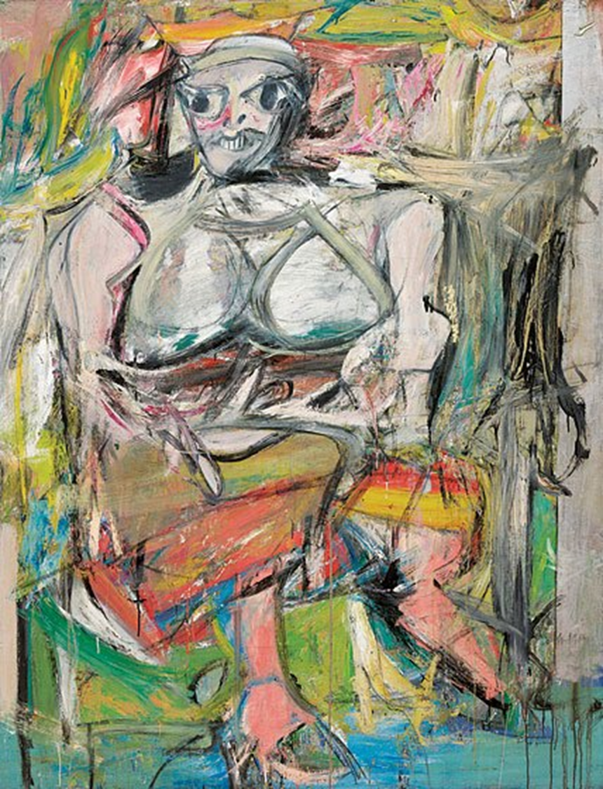
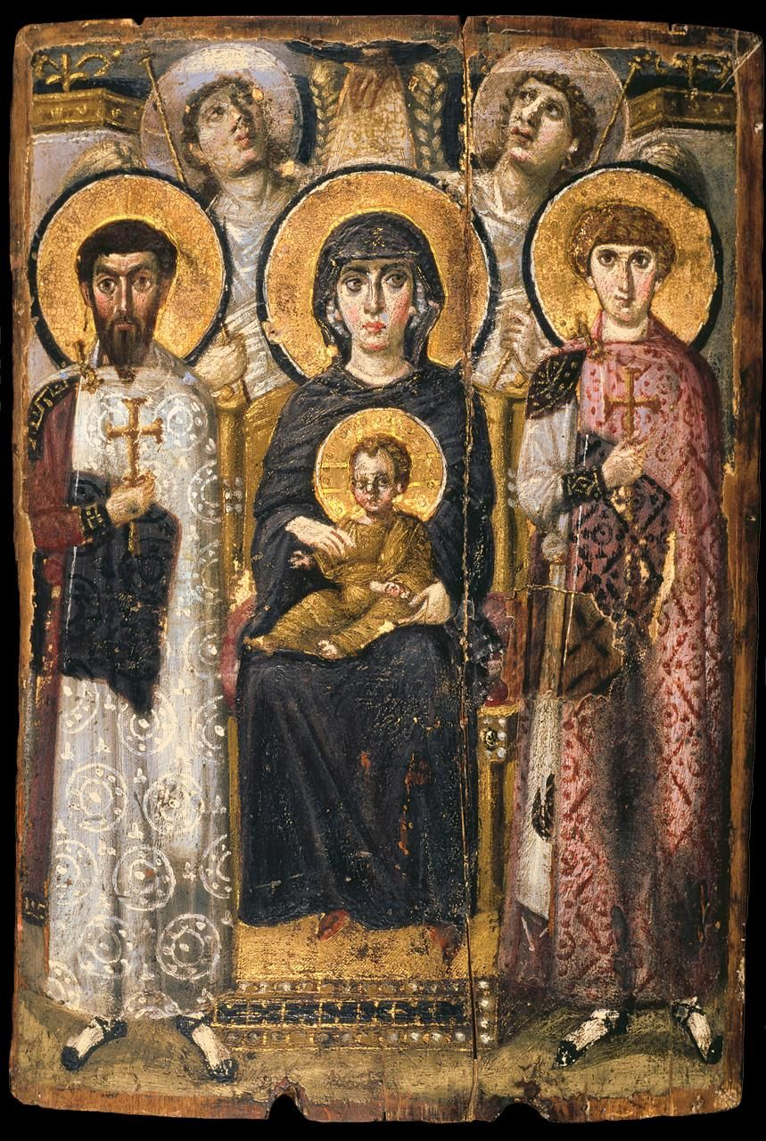
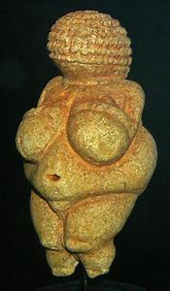
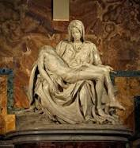
Modern Art = Simplifies
&Influenced by the
Primitive/Tribal

Slide 12
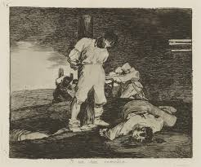
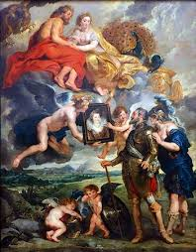
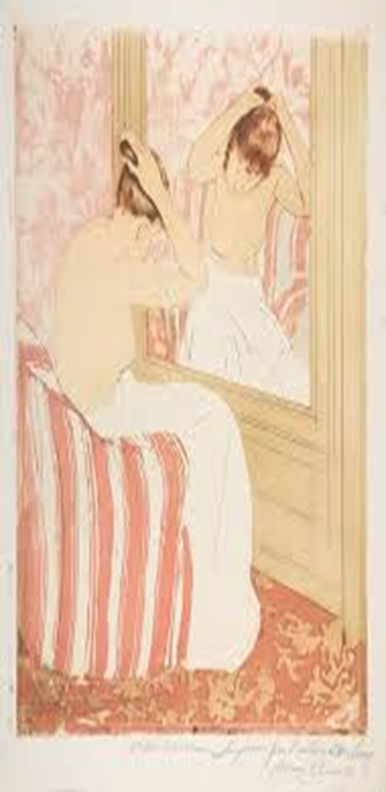
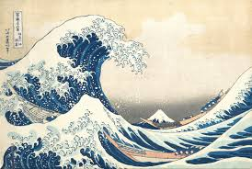
ART THAT IS PART OF A SERIES Narratives & Propaganda

Slide 13
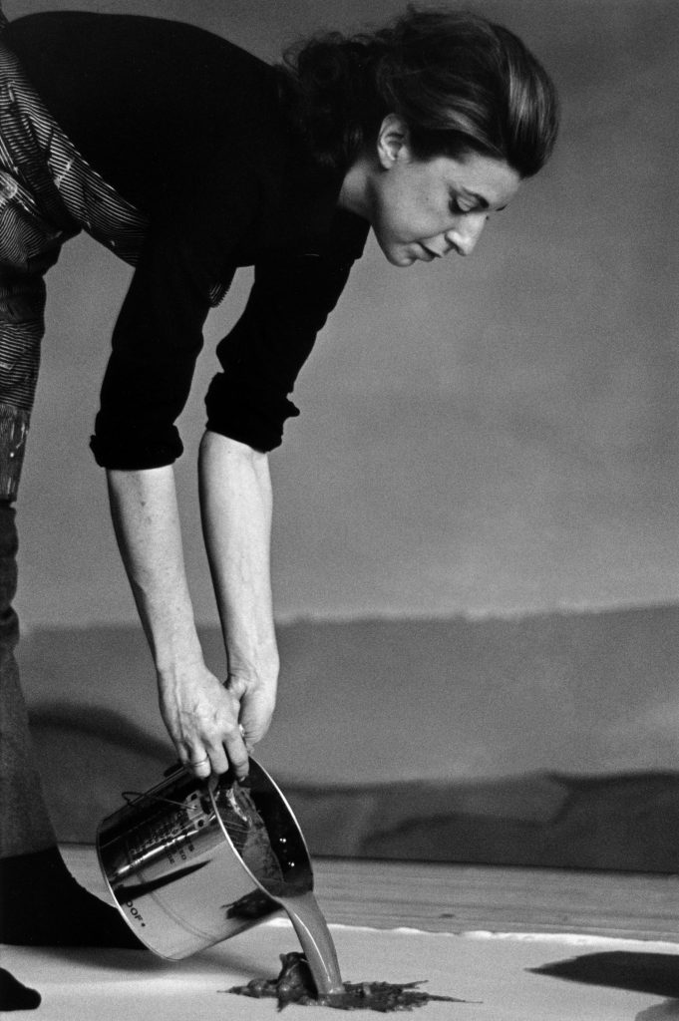
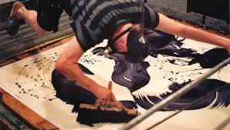
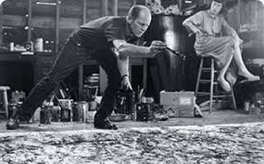
ABSTRACT EXPRESSIONISM USES ACTION PAINTING MANIPULATING THE PAINT ON THE CANVAS WHICH IS OFTEN ON THE FLOOR & THROWING OR POURING PAINT ON THE CANVAS

Slide 14
The Bay-Helen Frankenthaler FORM: Huge & Geometric Reduced to Shape & Color, Flat, Fluid, Discordant Color, Action Painting= Soak & Sink

Slide 15
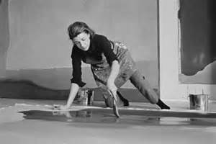
The Bay-Helen Frankenthaler 1963 Acrylic on Canvas-6 foot Tall FUNCTION: Abstract Expressionist= CONCEPTUAL ART
CONTENT:
1)Imposing Fluidity of BLUE
2) Paint poured onto the canvas
when it was wet= Action Painting
3) Soak-stain method with
diluted acrylic paint=She would l
lift canvas & tilt it
4)Wanted a Purposeful Image
to appear Spontaneous & Accidental
CONTEXT:
Abstract Landscape
Experimental & Innovative

Slide 16
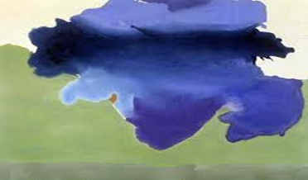
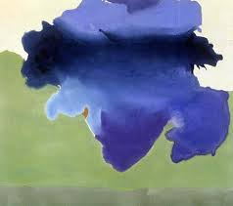
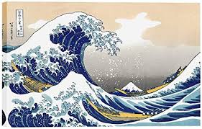
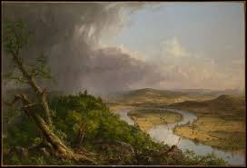
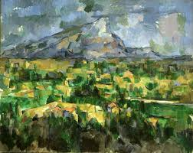
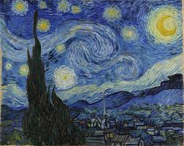
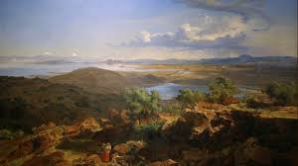
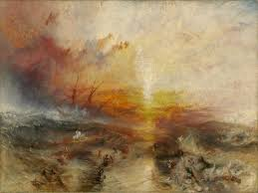
Landscapes Power & Beauty of Nature

Slide 17
Lipstick
(Ascending) on
CaterpillarTracks
- Claus Oldenburg
FUNCTION:
POP ART=
USING POPULAR IDEAS &
IMAGES TO COMMUNICATE
MEANING
ANTI-WAR SCULPTURE
FORM:
PHALLIC
CONTRASTING IMAGES:
BULLET-LIKE LIPSTICK &
TANK TIRES
HUGE=IMPOTANT IDEA
CONTEXT:
CONTENT:
1)MAKE LOVE=
LIPSTICK=
EROTIC &
SEXUAL
2) NOT WAR=
TANK= VIOLENCE
&
VIETNAM WAR
3)AGGRESSION=
BULLET-LKE,
RED COLOR
& TANK
4)WHIMISICAL=
GIANT LIPSTICK

Slide 18
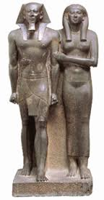
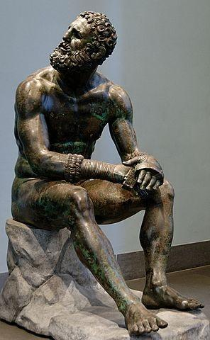
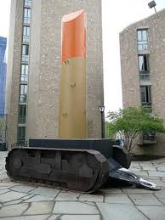
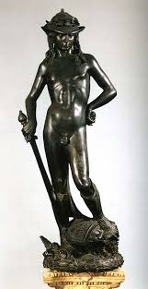
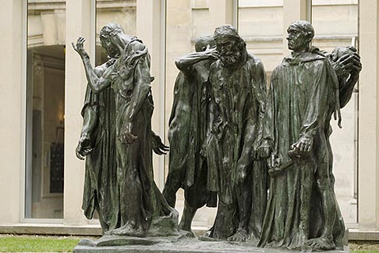
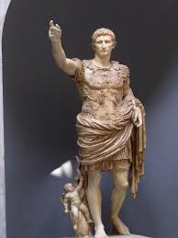
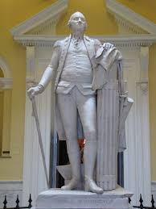
Theme: Sculpture That Conveys Cultural and/or Historical Messages

Slide 19
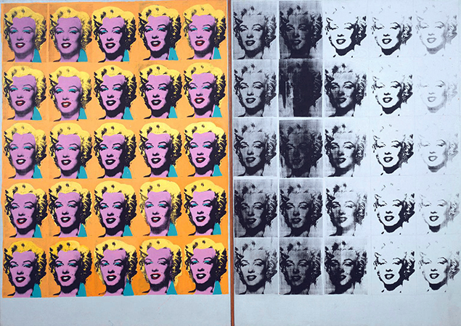
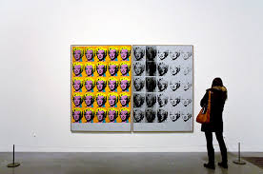
Marilyn Diptych, Andy Warhol
1962, oil, acrylic, silkscreen enamel on canvas (Tate Gallery-- London)
FUNCTION:
Funerary= Honors Marilyn Monroe
POP ART:
*A reaction against abstraction expressionism
*Glorifies + magnifies the commonplace
*Bridges the gap between "high" art & pop culture
*Often centered around mass production & replication
FORM:
Two- sided= Diptych
Colored and Black &White
Repetitive Images
Contrast of Clear Images & Blurred Ones
Huge Ideas about Art &
Honoring Marilyn Monroe’s Death

Slide 20
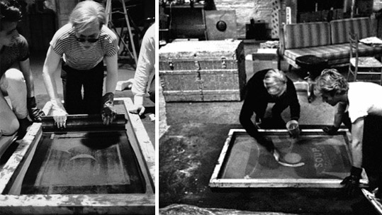
TECHNIQUE: SILK SCREENING
Stenciling with Paint to Create a Graphic Image

Slide 21
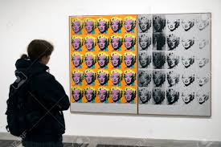
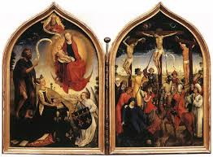
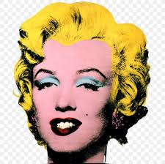
CONTENT:
Illustrates Life & Death
Shaped like a Diptych=
tells a Narrative from Life
to Death= like the life
of Christ
3)Looks like a Film Strip=
M. Monroe was a Film Actress=
honors life * her ability to construct illusion
4)Art is about Artifice/ Not Being Real
M. Monroe great example of illusion
=not a blonde, no beauty mark ….
CONTEXT:
MONUMENTAL SIZE=more than six feet by nine feet) demands our attention and announces the importance of the subject matter.
PROCESS=
Seemingly careless handling of the paint
&
the silkscreen process and repetition to make art that is not about his interior life, but rather about the culture in which he lived.
Life Death

Slide 22
Real Vs. Illusion/Stereotype Norma Jean Vs. The Sexualized Image Conceptional Idea=Art is about Illusion

Slide 23
Narcissus Garden- Yayoi Kusama
Function – Critizes Society & Consumerism
FORM:
Photograph of Performance art
Reflective Stainless-Steel Balls
CONTENT:
1500 reflective balls
Stainless steel balls
on lawn
Sign =
“Your Narcissism on Sale”
Offered balls for sale for
20 lira = $2 dollars
CONTEXT:
Commentary on
Commercialism & Vanity in
Modern World
Later moved Installation to
Water= where balls floated &
reflected itself = like myth about Narcissus
Organically moved w/ wind & water
Re-exhibited with both land & water in Museums
Images reflected in the ball
Are "repeated, distorted, and projected"

Slide 24
KUSAMA USES MIRRORS TO CONSTRUCT HER INFINITY ROOMS

Slide 25
Artwork That Uses Mirrors Perspetive & Identity

Slide 26
Spiral Jetty- Robert Smithson Black Basalt Rocks on a Salt Water Lake SITE/EARTH ART
Form:
- mud, salt crystals, rocks, water coil
- on the Great Salt Lake in Utah
- this was a very abandoned place, extremely remote
used a tractor with native stone to create the jetty
Monumental
FUNCTION:
EARTH SCULPTURE
CONTENT:
1)Primitive symbol for spirituality
2)In Situ=built in the same location of the material/medium
3)Sublime= makes the audience feel small in its presence
4)Testament to the destructive & create power of nature=
erosion & water

Slide 27
C
O
N
T
E
X
T

Slide 28
In Situ Sculpture & Architecture

Slide 29
HOMEWORK
SEND ME YOUR
LATE MODERNISM NOTES
&
SEND A RESPONSE TO
MY INSTAGRAM
@ROGERSAPAH
TAKE THE QUIZLET
DETERMINE WHAT YOU DON’T KNOW
CREATE STICKY NOTES & POSTERS

