Slide 1
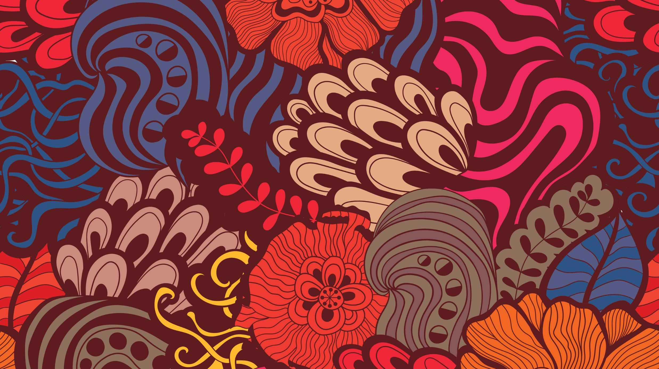
Indigenous American Art
Central American Art
Mayan- Aztec

Slide 2
REMEMBER THE TWO TYPES OF QUESTIONS ON THE 2020 EXAM KEEP THIS IN MIND AS YOU LEARN NEW ART WORKS
25-Minute Long Essay Response
Focus on Comparison of Theme
Ritual, Power & Authority
Gender, Depiction of Human Form, Sacred Space & Object
Landscape , Man’s Relationship with Nature
15 Minute Short Essay
Response
Focus on
Continuity & Change
How art reflects & deviates from Tradition?

Slide 3
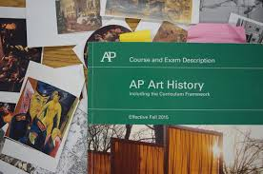
Tips for the Exam
HARDWARE:
Open (2) Windows
5 minutes to upload
Security Procedure
Keep on EYE on the TIMER
=5 minute for upload
Type or Write the Prompt
Free Up Your Internet
= No Games
CONTENT:
Organize your Notes
Open Book & Notes
NO Time for Research
Use What You KNOW
Theme=
*Use the provided Works,
*Works form Unites 7-10,
*Any work You Know

Slide 4
Go to My Website To View & add images YOU WILL NEED 7 PAGES

Slide 5
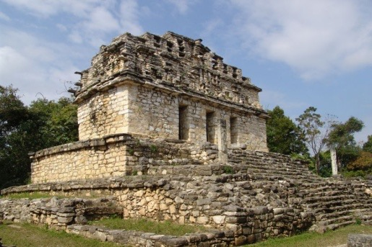
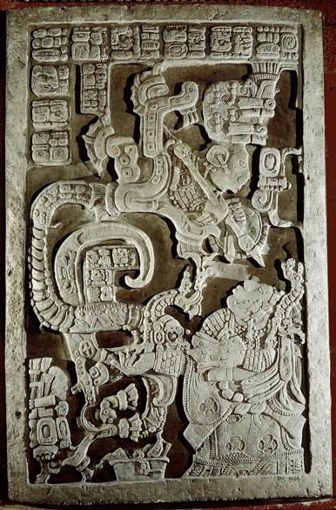
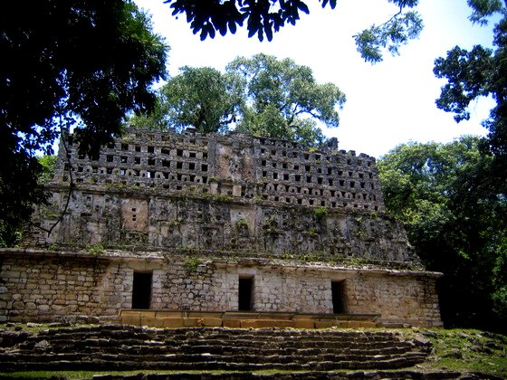
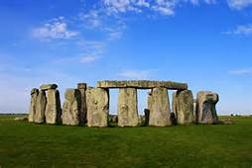
155. Yaxchilán= City Scape
Chiapas, Mexico. Maya. 725 C.E. Limestone (architectural complex). (3 images)
Central Maya site, located just inside Mexico, on the Mexico/Guatemala border
Located along a important waterway
Ancient name for the city was Pa’ Chan meaning cleft of broken sky, or split-sky place
Across the river two mountains split the sky
Buildings were made to align with the rising sun on the summer solstice
Cleft is symbolic formation
Dent in head of symbolic jaguar
Splitting of the corn seed
References birth
June solstice sunrise rises between the two mountains and hits structure 33
Structure 40
Lintel 25, Structure 23
Structure 33
Like STONEHENGE=Aligned with Solstice

Slide 6
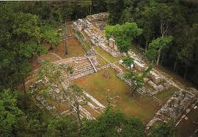
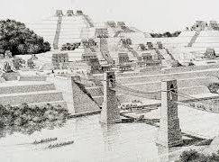
Yaxchilan Mayan City Scape one of the most powerful Maya states along the course of the Usumacinta River,

Slide 7
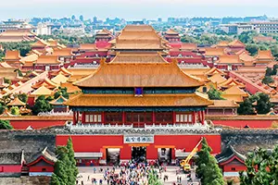
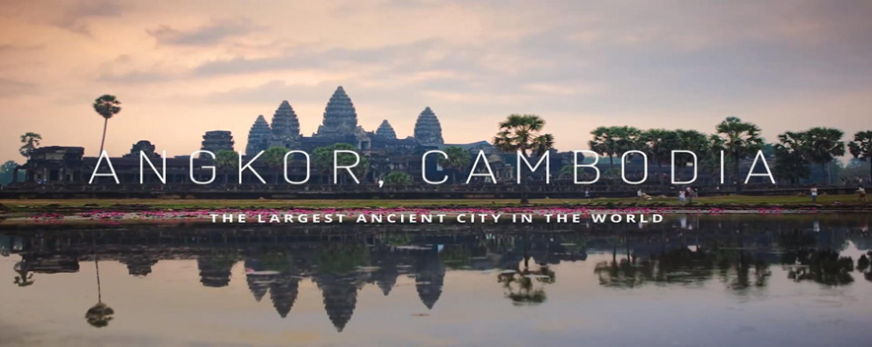
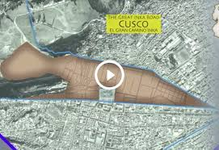
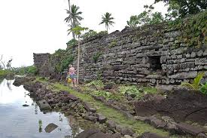
THEME: CITY SCAPES

Slide 8
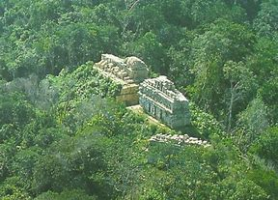
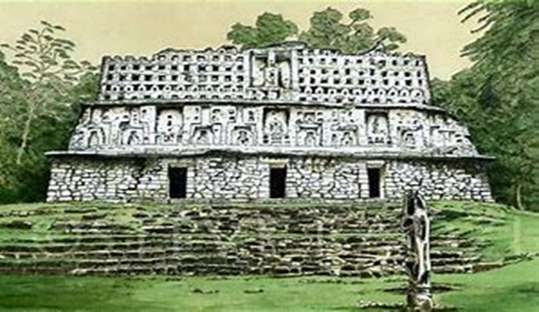
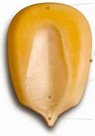
DRAW
Yaxchilan Structure 33
5)
4)
6)(
2)
FORMAL Characteristics
Elevated = Power & Flooding
Post & Lintel Construction & Ashlar Masonry
On Mountain in Rainforest
= Sacred & Protected
4) Chief’s Head-Dress Like Roof =
=Power & Authority
5) Structure 33= Aligned to the Sun
6) Clefts= Jaguar, Corn & Birth Canal
1)
3)

Slide 9
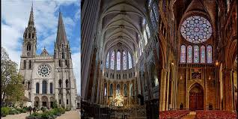
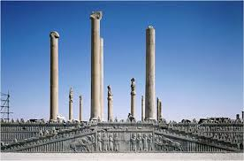
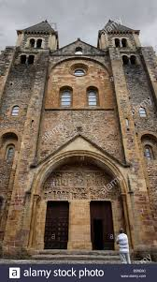
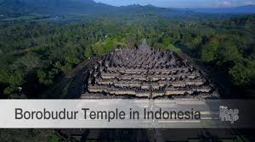
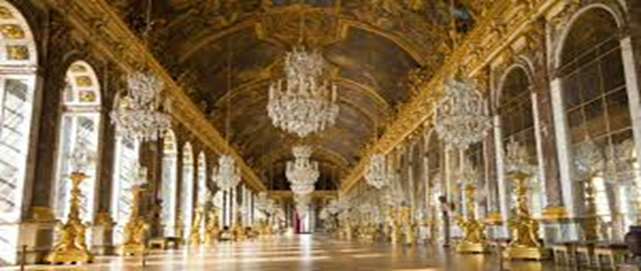
Theme: BUIDINGS WITH CULTURAL/RELIGIOUS NARRATIVES

Slide 10
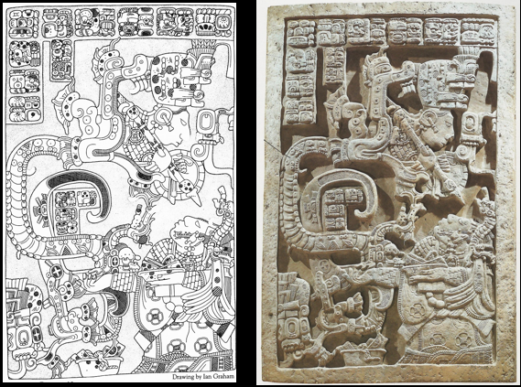
Lintel 25, Structure 23

Slide 11
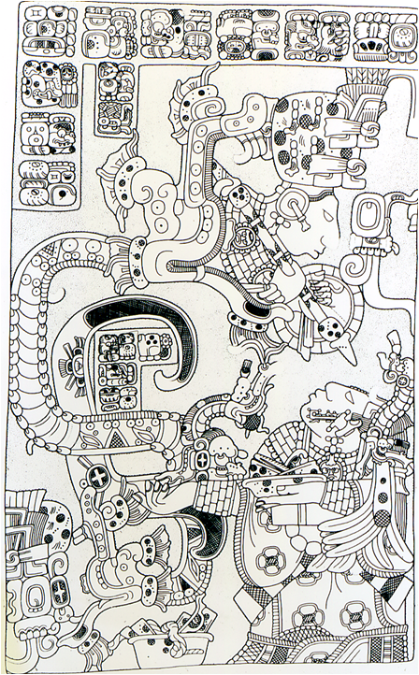
Lintel 25, Structure 23=
Lady Xoc’s
Blood Letting Relief
USE COLORS TO
ANALYZE WORK
(YELLOW) GYLPTHS
Pictorial Mayan Language=
Narrative= Tells Story
2) (Blue) LADY XOC
POWERFUL
Royal Sister to The King
Psychic= Able to Connect to
Spirit World through
Blood Sacrifice
POWER=Blood
STATUS=Jewelry
& Elaborate Outfit
3)(RED) VISION
from Blood Sacrifice
Connection to Spirit world
Symbolized by SNAKE &
WARRIOR
SNAKE= Sacred Animal
WARRIOR
VISION
Lady Xoc’s Blood on Paper

Slide 12
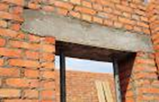
Lintel Over the Door of Building
Propaganda= Illustrates & Narrates Lady Xoc Power
Audience Looks Up= Honors Lady Xoc
Teotihuacan-style war helmet= Power
Shield, with Weapon
Warrior= Represents
Power of
Lady Xoc’s Vision
Chaak Mask-Rain Rain deity w/
Jade collar and bracelets
Baskets with bloody paper t
Burnt so blood sacrifice rises to deities & connects to spirit world
Blood =marker of connection & relationship w/gods

Slide 13
Rare occurrence in Maya architecture
Promotion of a woman in a highly patriarchal society
Also a polygamous society with husbands having multiple wives and heirs
Was built for Lady Xoc (shock)
Principal wife of three wives to Shield Jaguar II ruled from 681-742 CE
Was his high-ranking aunt and gave him no heir
Structure was built to appease his aunt-wife and to remind others of the status linked to him
Did not have primogeniture
Would have spanned the lintel on the upper doorways of the building
Numbered by archaeologists
Was considered the “heart” of Yaxchilan and also “Bee’s House” to signal the hive of female activity or to reference the importance of the queen to the hive
Below the structure a tomb was found that contained the remains of a mature woman wearing 431 greenstone beads and over 30 ceramic vessels
Also found over a hundred obsidian (volcanic glass) blades in the tomb
Bone blood-letters- pointed implements for piercings with her name to show devotion to royal act
Blood-letting is seen throughout
On strips of bark that would have been set fire to and would have been the way to reach the ethereal realm
Would have led to visions
SNAKE VISION

Slide 14
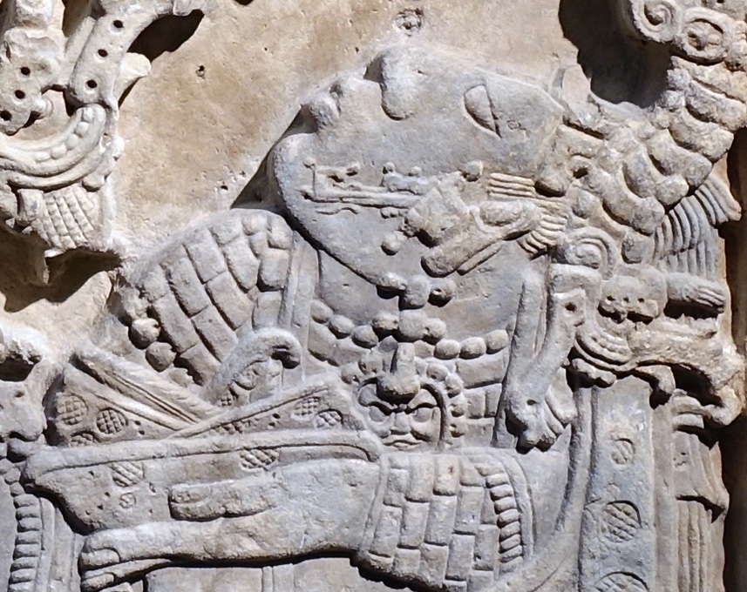
Headdress & Jewels= Wealth & Power
.
Blood Stained Paper in Bowl
Burnt Offering to Gods
For Serpent Visions & Blessings
Knelling before Vision

Slide 15
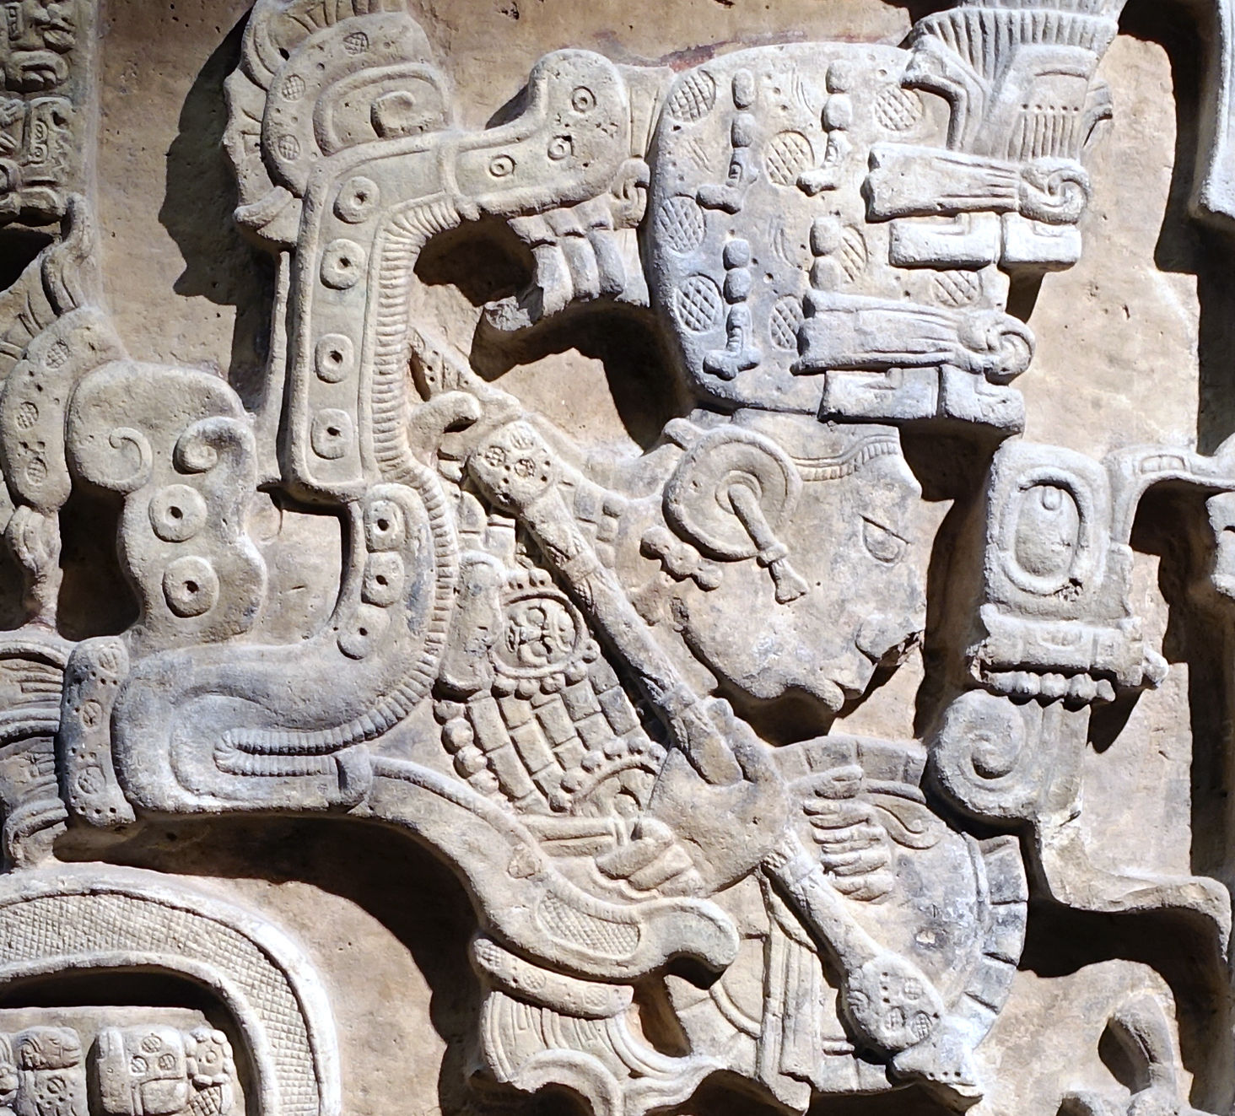
Figure emerging from the vision serpent’s mouth is armed with a shield, spear and a war helmet

Slide 16
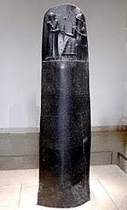
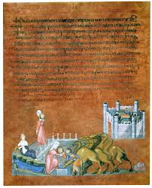
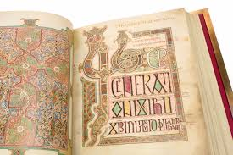
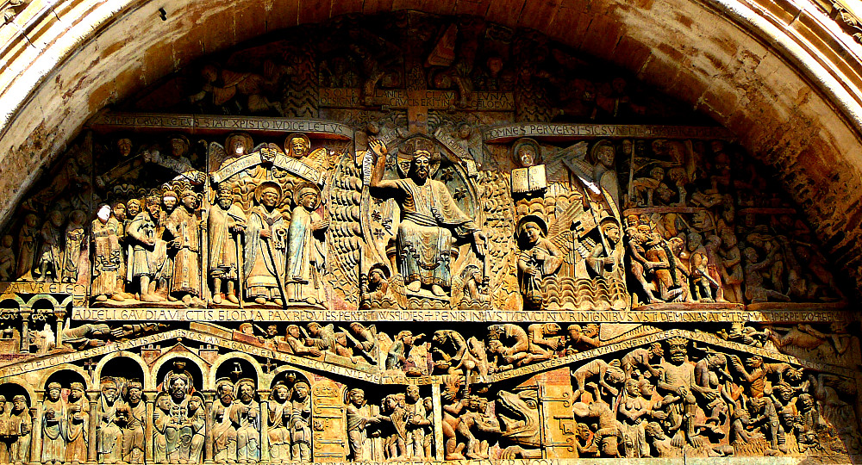
Theme: Art that Combines Text & Imagery to Tell Narrative

Slide 17
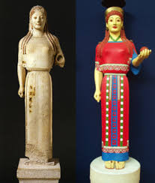
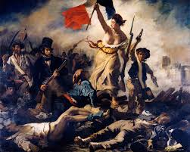
Theme: Depiction of Female Form as Cultural Motif

Slide 18
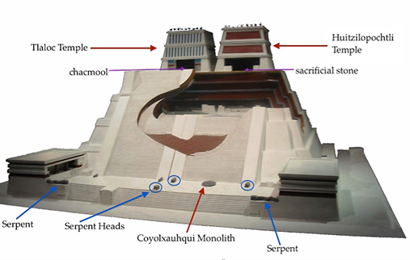
WATCH THE VIDEO ON KHAN ACADEMY &
CONSTRUCT THE F2C2
https://www.youtube.com/watch?v=86zSgZWVkVk
ATTRIBUTION:
157. Templo Mayor ( Main/Great Temple). Tenochtitlan (Modern México City, Mexico). Mexica /Aztec . 1375–1520 C.E. Stone
FORM: FUNCTION:
CONTENT: CONTEXT:
ART CHARACTERISTICS
1)
2)
3)
4)
Templo Mayor was positioned at the center of the Mexica capital and thus the entire empire.=Aligned with the Sun
The capital was also divided into four main quadrants, with the Templo Mayor at the center.= Symmetrical=POWER
This design reflects the Aztec cosmos, which was believed to be composed of four parts structured around the navel of the universe, or the axis mundi

Slide 19
Templo Mayor for Ritual Sacrifice =ZIGGURAT -LIKE
90 Feet High and Hollow= RITUAL & SACRIFICE TO SUN GOD
Dedicated to Deity of Water & Rain=Fertility
& The Sun =Power
Two deities symbolized the Mexica concept of atl-tlachinolli, or burnt water =duality=fire & water= both creates /destroys=illustrates warfare— primary way in which the Mexica acquired their power & wealth.

Slide 20
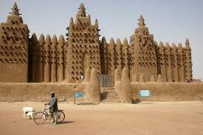
Theme: Sacred Spaces that Communicate Cultural Identity

Slide 21
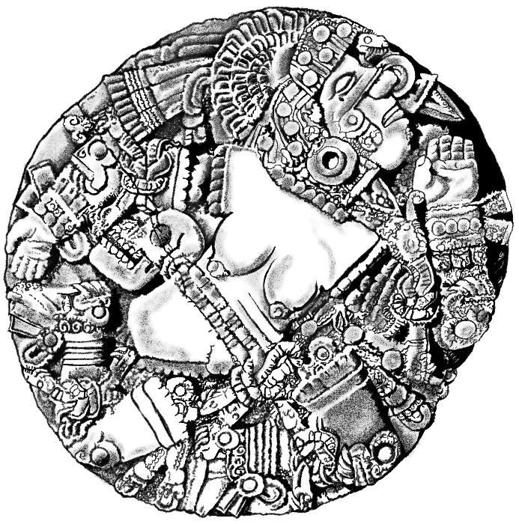
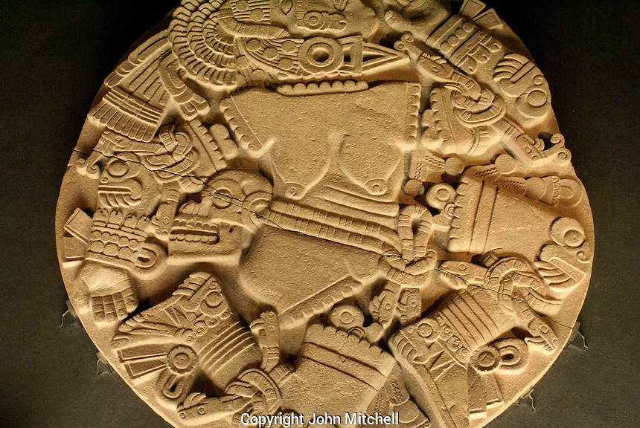
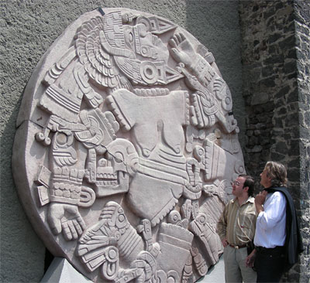
FORM:
*Painted
*High Relief
*Female Nude
*Monolith
*Circular
*Huge
FUNCTION:
*Sacred Object
*Myth
*Communicates
Cultural Identity
*Warning To Enemies
CONTENT:
Skull=Death
Head Dress =
Power
Dismembered=
Phases of the moon=in pieces
CONTENT=VIOLENCE & BLOOD
CELEBRATES AZTEC STRENGTH
BLOOD CONNECTS TO ANCESTORS & GODS
The Coyolxauhqui Stone
Aztec @Templo Mayor
c. 1500. volcanic stone
CONTEXT:
Found at Base of the Stair
of Templo Mayor=Kept Inside the Temple like Lazon Stela
Depicts Myth of MOON Goddess
Honors gods & mountains
Children of Earth Goddess
Sun & Moon
Represents the Defeated &
Dismembered MOON goddess
Conquered Enemies & Sacrifices = Dismembered & Beheaded & Thrown to the BOTTOM of the
TEMPLE STAIRS=Re-enactment
Art in Service to State=Propaganda=Make Enemies Afraid of Fierceness of Aztec Civilization
Decapitated Head
Skull
Body
Parts
Warrior’s belt

Slide 22
LIKE GREEK SCULPTURE- ORIGINALLY BRIGHTLY PAINTED

Slide 23
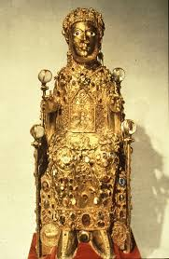
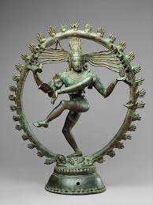
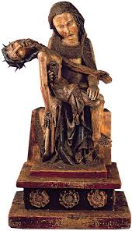
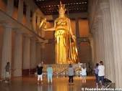
SACRED OBJECTS THAT ILLUSTRATE A CULTURAL NARRATIVE

Slide 24
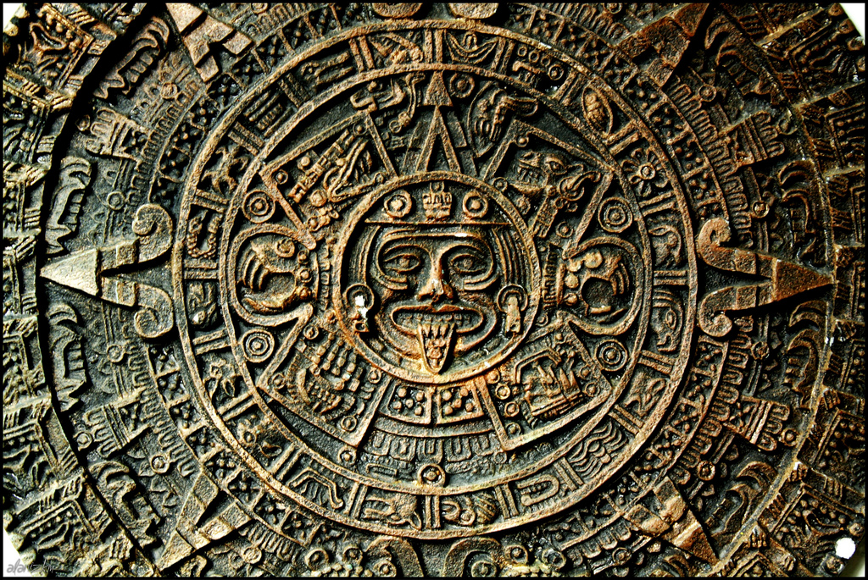
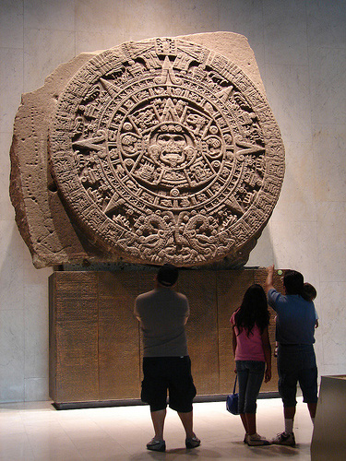
FORM:
*Basalt Disk w/ glyphic
*High Relief
*Monolith
*Circular
*Huge=12 feet high
24.5 Tons
FUNCTION:
*Sacred Object
*Narrates Aztec Creation
Myth
*Altar (center of
disk has a knife)
*Dedicated to Mtecuhzoma II
=right to rule=sacred power of time
CONTENT:
*Bands=20 days of Aztec Sacred
Calendar=260 day Sacred Year
*Outer Bands= (2) Fire Serpents=
transport Sun god through daily journey
*Symbols of bones, hearts & skull
=represent death, sacrifice and
spirituality
SUN GOD OR KING
Knife= drawn & real life
SNAKES
CONTEXT:
Altar for Ritual Human Sacrifice
Ceremonial=lays flat
Blade= both drawing & placement hole
Center =Sun God=Center of Aztec belief
Unearth by Workers making Repairs
On Mexico city’s main plaza
Calendar Stone/SUN STONE
Aztec-Basalt-1427

Slide 25
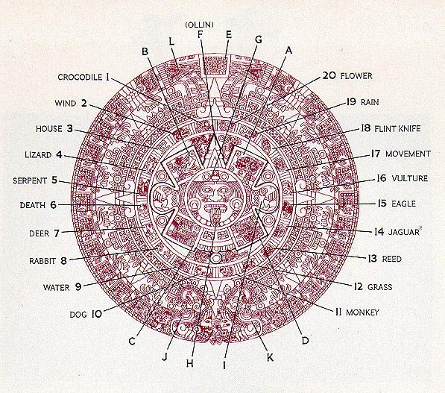
HORROR VACULI OF MOTIFS
ANIMALS, WATER , ELEMENTS & PLANTS
ASSOCIATED WITH SEASONS
Use Art Vocabulary to
Describe Form & Meaning:
List (3) Visual Qualities:
Themes:
Sun Worship
Kingship
Time
Power
Cultural Id.
SNAKES with holes for sticks =used as sundial

Slide 26
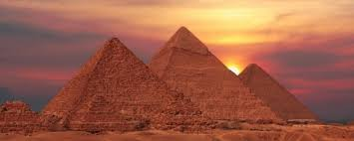
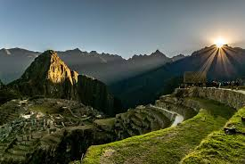
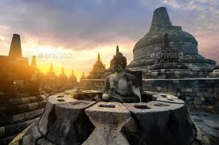
THEME: SUN WORSHIP

Slide 27
FEATHERS= SPIRITUALITY BIRD FLY IN THE SKY= HOME OF THE GODS
Feathers were a very important part of the Aztec Economy
Art made of feathers were seen as a symbol of wealth and status
Were used to create fans and shields as well as headdresses
Were also a part of a warrior’s clothing
Especially rare feathers were received as payment from cities conquered by the Aztec Empire

Slide 28
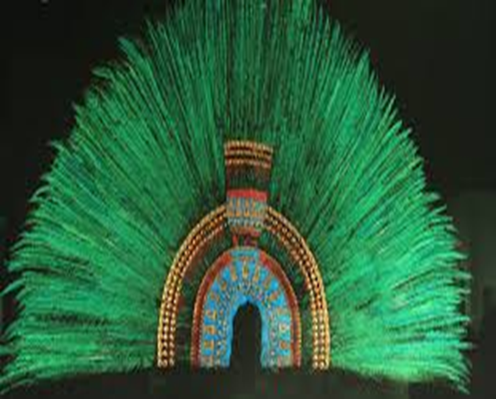
Ruler's feather headdress (probably of Moctezuma II)
THEME-KINGSHIP & POWER
Anti=Colonial= In Austria & Mexico wants it back
Form=
Increases wearers height & verticality
Makes the wearer large & more colorful (green, blue & gold)
Originally has a bird’s beak= predator & spiritual
Function= Like CROWN/
Ritual & Ceremonial
CONTEXT:
Presumably belonged to Motecuhzoma II, ruler of the Aztec Empire
Capital of the Aztec Empire was Tenochtitlan (present-day Mexico City)
Acquired by Hernán Cortés, a conquistador who led an expedition that led to the fall of the Aztec Empire
Sources vary on whether the headdress was gifted as a diplomatic gesture or taken forcefully

Slide 29
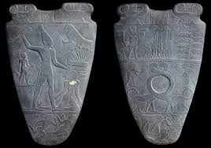
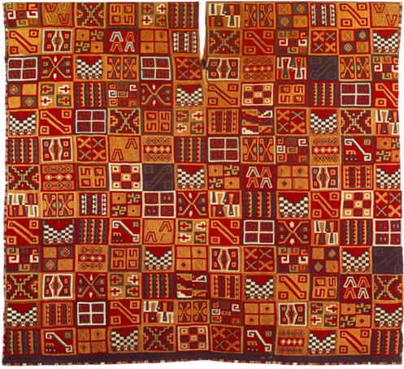
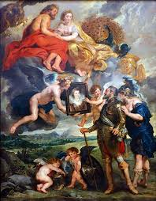
THEME: KINGSHIP

Slide 30
OLMEC MASKS= Communicates Cultural Identity
OLMEC=earliest Central American civilization and laid the foundations for subsequent societies
Mask looks like OLMEC Sculptures
Connects to Ancestors & History
Olmec Stone Mask
900-400 B.C.E
Greenstone
Olmec Stone Mask
900-400 B.C.E
Greenstone
Worn around the neck as a pendant=JEWELRY
*** No Eye Slits or Nose Holes
Toothless, down-turned mouth and infant-like face are typical of Olmec art.
Small & Symmetric=Personal
Ears are perforated and the mask may have originally been decorated with piercings.
On either side of the mouth are two Olmec glyphs (picture signs)=the earliest known writing in America.
This Olmec mask was worn around the neck as a pendant. It may have provided the wearer with a new identity as an ancestor or deity - perhaps as the Olmec rain god.
The distinctive toothless, down-turned mouth and infant-like face are typical of Olmec art
POWER & AUTHORITY
STATUS & WEALTH

Slide 31
Theme: Wearable art illustrating Status & Wealth

Slide 32
THEME: MASKS honor cultural traditions

