Slide 1
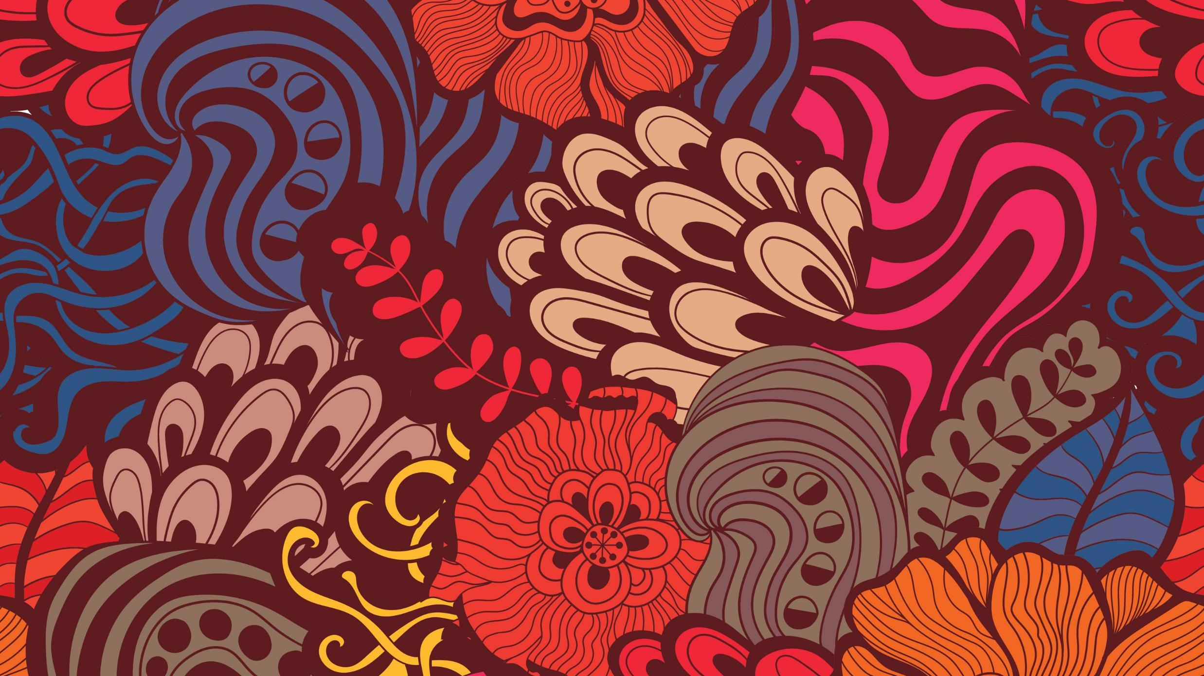
Indigenous American Art
Chavin Art-
Machu Picchu

Slide 2
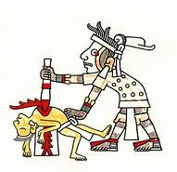
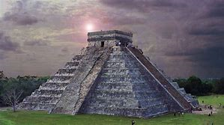
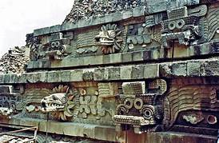
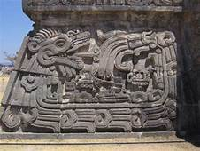
Common Art Details Indigenous American Art
BIG
IDEAS
Ashlar Masonry
Created
Stable & Solid Structure
Underground= Fertility & Mother Earth
Pyramids & High Structures= Sun God= Power & Authority
Blood
Power
Activates the Spirit World
Connects to gods
Stimulates Fertility , Agriculture & Blessings
SNAKE MOTIFS
Wisdom & Power
Connection to Mother Earth
Umbilical Cord
Bridge between the Living World & Afterlife

Slide 3
Chavin Religion= Power & Authority and FERTILITY
Staff Deity=looks like Farming Tool
Associated with agricultural fertility and usually holds a staff in each hand
FEATURES OF JAGUAR= FAND, CLAWS & FACE= POWER
SNAKE-SACRED ANIMAL =BRIDGE FROM LIVING WORLD TO AFTERLIFE
Rituals
Multi-sensory perspectives
Included blood-letting and sacrificial rituals =increase fertility
Performed in public spaces accommodating up to 1,500 people
Cult of Shamans
Put themselves in trances with hallucinatory plants
Burning of incense and appearing atop temples via secret internal staircases, along with musical sounds added to mystery
BIG
IDEAS

Slide 4
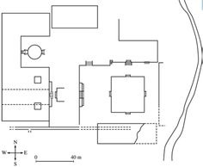
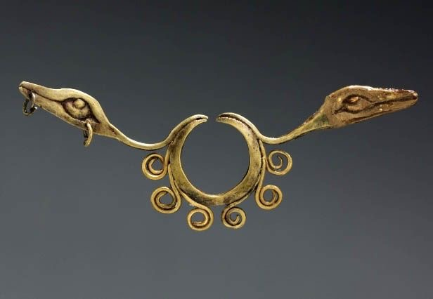
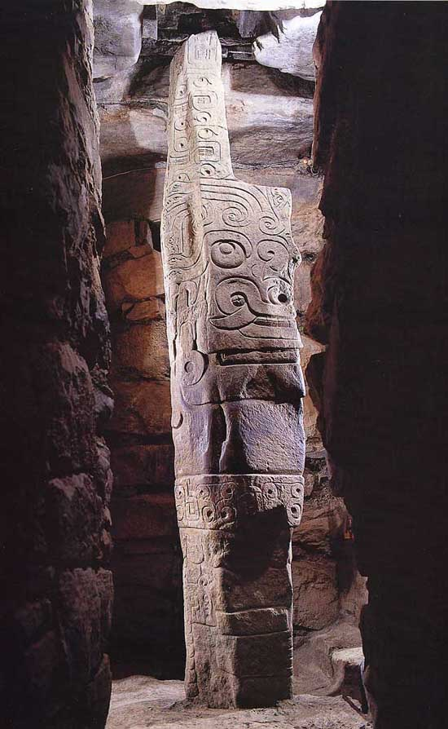
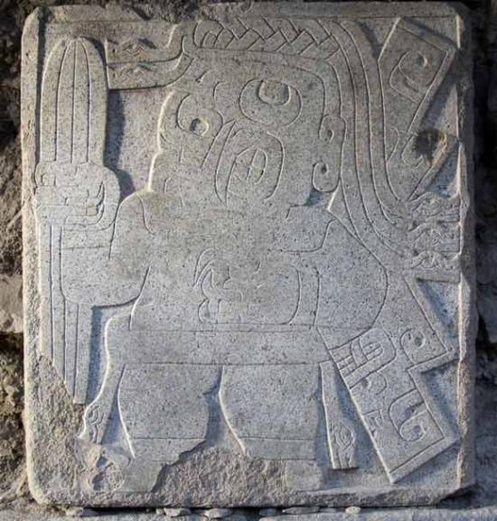
153. Chavín de Huántar. Northern highlands, Peru. Chavín. 900–200 B.C.E.
Stone City (architectural complex), Granite Lanzón sculpture, Hammered Gold Nose Ring (jewelry) & Stone Relief Guardian . (4 images)
Chavín, earliest highly developed culture in pre-Columbian Peru, which flourished between about 900 and 200 bc
Name=derives from the great ruin of Chavín de Huántar in the northern highlands of the Peruvian Andes
Ground Map
Nose Ornament
The Lanzon Stela
Relief Sculpture

Slide 5
ATTRIBUTION:
Lanzón Stela,,
@Chavín de Huántar
Northern Highland-Peru
900-200 BCE
GRANITE
1)Looks like an
agricultural
Tool
Snake eyes
& Shape
FORM: FUNCTION:
*Anthropomorphic *Sacred Object
*Bas Relief *Fertility & Religion
*Vertical & Phallic
*Huge=Powerful ART THEME
*Symmetrical Power & Authority
* 15 feet high Spirituality
CONTENT: CONTEXT:
ART CHARACTERISTICS
1)
2)
3)
4)
2)FACE=
Represents
an
agricultural
god w/fangs
&claw of a
JAGUAR
=power
3)Geometric
Motif=
Relationship
between
Man & Nature
4)Underground in a Dark
Circular Sacred Space

Slide 6
CONTEXT: Powe & Authority * Size * Shape * Fang ON FACE* Location Within Mother Earth
Shows the god for whom the temple was built=Granite Phallic Stela & Snake Motifs for Hair
Snakes= Sacred= Bridge From Living to After Life
Located deep within the Old Temple= Underground= Womb/ Center of the Earth=Power=LINKS
LIVING & AFTERLIFE LIKE AXIS MUNDI
=ANGKOR WAT
LANZON means “great spear” in Spanish, in reference to stone’s shape= Conquistadors mistook the shape for a spear
SHAPED LIKE DIGGING STICK=
Compared to a digging stick used in traditional highland agriculture
Indicates the deity’s power in ensuring a successful harvest=
FERTILITY
Worshippers would be led into the maze of pitch-black tunnels, eventually coming face to face with the sculpture. Disorientation
&hallucinogenic effects of various drugs
heightened the visual and psychological impact of the sculpture
size & face
JAGUAR CULT=
SACRED ANIMAL =
PREDATOR & POWERFUL

Slide 7
Chavín de Huantar Temple Lanzon Stela Buried Inside
DRAW AND LABEL THE MAP
Underground
Location of Lanzon
Old Temple
COMPLEX & INNOVATIVE
Drainage System= No Flooding
Canals Built under the Temple
Water Rush through Canals & Sound Like a Jaguar ( Sacred Animal)
White Limestone & Black Granite= Duality
Advance Skill in Metallurgy= Goldsmiths
( Able to create & control high temperatures)
Sunken Plaza
New Temple
Sunken
Plaza Mayor
Black/White
Staircase
WATCH
https://www.youtube.com/watch?v=PnIoffCCyBI

Slide 8
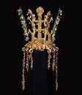
Nose Ornament=Status & Power
2 Serpents Flanking Circular Piercing
Hammered Gold=STATUS & WEALTH
FORM:
BIRD head
Geometric motifs
Symmetrical
Hammered gold
Sun shapes
CONTENT:
ZOOMORPHIC
*BIRD HEAD=
CONNECTION MAN
& MOTHER EARTH
*DUALISM=Life/Death
CONTEXT:
Pinched or passed through the Nose
Would have been worn by an elite person to show wealth, power and allegiance to the Chavin religion
Showcases Chavin’s knowledge of Metallurgy=FORGE METAL INTO INTRICATE SHAPES=KNIVES & MACHETES
Objects came to embody wealth and religion
Elite Men & women wore them to represents belief & status
Often Funerary= People buried with them
FUNCTION:
Sacred Metal Jewelry
Like Gold Jade Crown
STATUS OBJECT= Merovingian Looped Fibulae

Slide 9
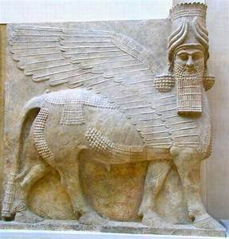
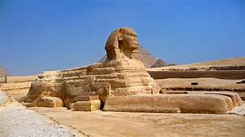
FUNCTION: COMPOSITE CREATURE=HUMAN & ANIMAL= GUARDIAN
THEMES: Power & Authority AND Spirituality
FORMS:
*Bas Relief
*Zoomorphic=
Jaguar head, fangs & claws
*Human Body
CONTENT:
WARRIOR=GUARDIAN
Power=
Headdress of Snakes
& Weapon (cactus)
Fang & Claws=Jaguar
CONTEXT:
Creates a barrier between those who can see its true form and those outside the cult who cannot
Similar iconography was used on the outside of the temple
*

Slide 10
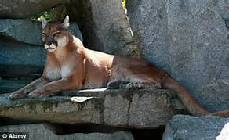
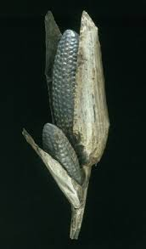
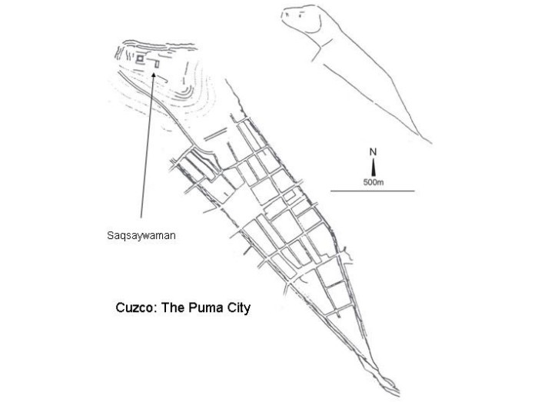
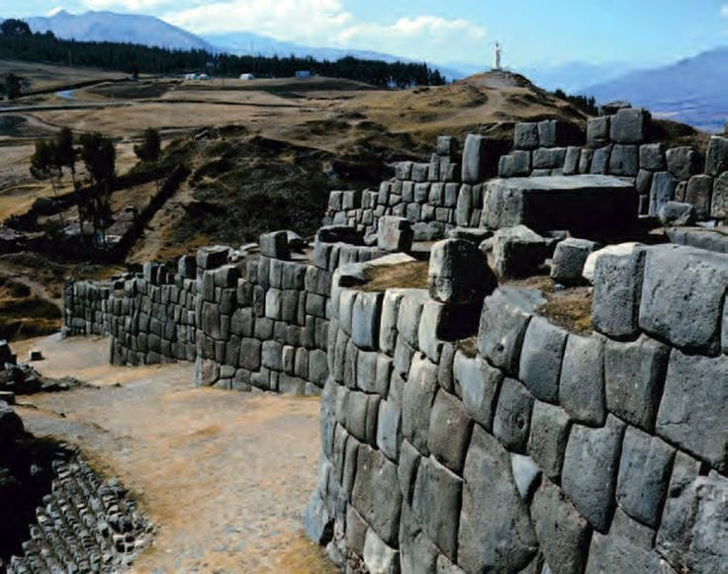
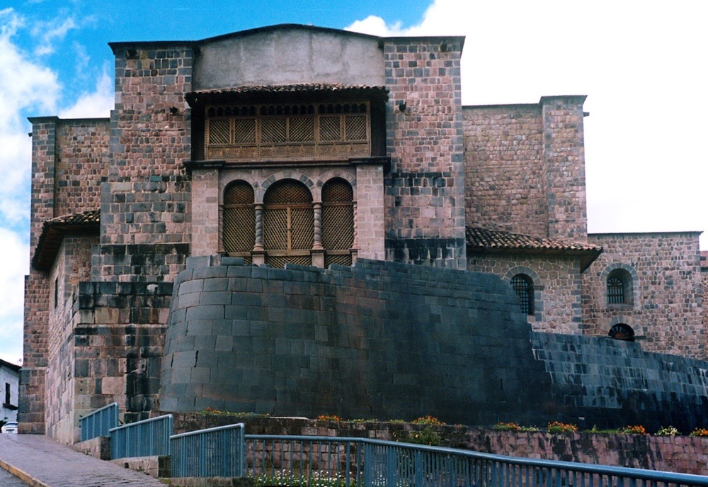
159.City of Cusco
=shaped like a Puma =Sacred Animal
(4) IMAGES
Construct an F2C2 by watching the videos at https://www.youtube.com/watch?v=H9Dd3hZVqMU
Saqsa Waman
(Sacsayhuaman)
Qorinkancha
(main temple
and convent
Map of Cusco
Maize Cob

Slide 11
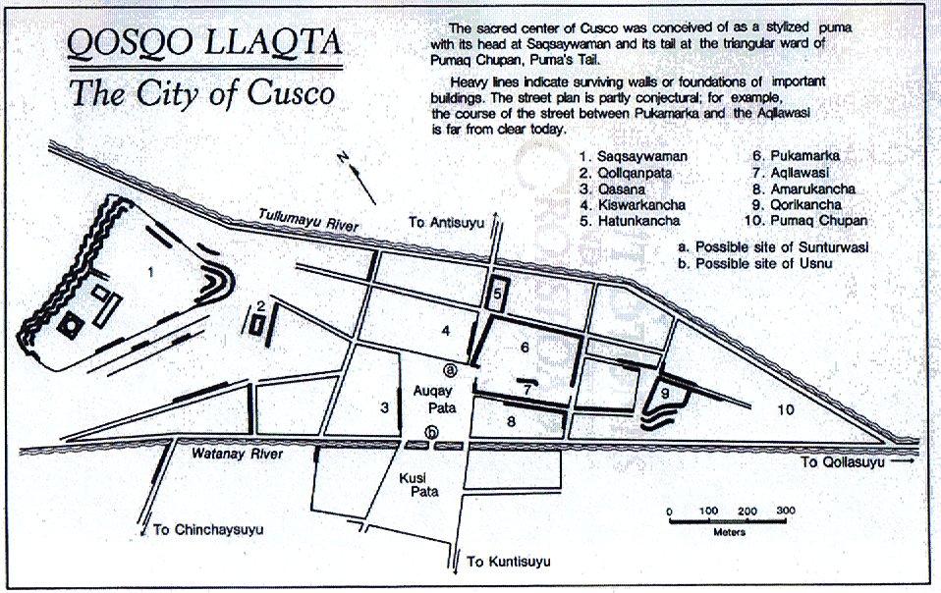

Slide 12
Sasqa Waman Citadel=Located on a steep hill that overlooks the city, the fortified complex has a wide view of the valley to the southeast Military Protection of City
Megalithic
Structure
Like
StoneHenge
Zigzagged
formation
= With Stand
Earthquake
Theory-
ASHLAR Masonry blocks at Sacsayhuaman were put into place by carving them precisely & they were dragged by rope to the construction site, a feat that at times required hundreds of men.

Slide 13
Qorikancha (“Golden House”)=Masonry Marked Time=Observatory Power & Authority SUN GOD
Located in the center of the lower part of Cusco
Most sacred shrine= dedicated to the worship of the sun
Had many gods, but claimed descent from the sun, called Inti
Was the center point of the empire=
Shrines were also a marker of time, as noble families held rituals around certain times of the year
After the conquest it was turned into a Monastary & Church=Transformation over Time=
Like Pantheon, Hagia Sophia, Great Mosque of Cordaba
Inside was a reproduction of the world in minature in the shape of a garden made from gold, silver, jewels, with people, animals, and plants
These were looted by the Spanish in 1532
MAIZE COB MAY HAVE BEEN IN THIS GARDEN

Slide 14
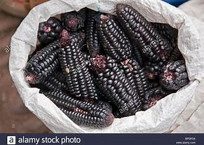
Draw
This
May Have been a
Part of the
Golden House’s
World Garden
Demonstrates
Valuable Incan
Resources
= Gold & Corn
REPOUSSE=
shaped or ornamented with patterns
in relief made by hammering or pressing on the reverse side — used especially of metal

Slide 15
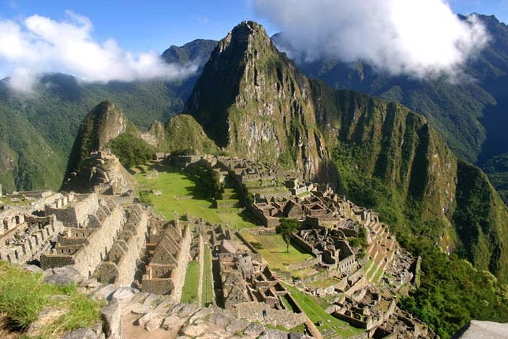
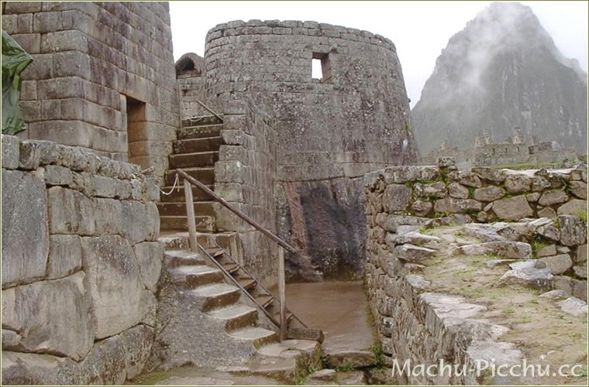
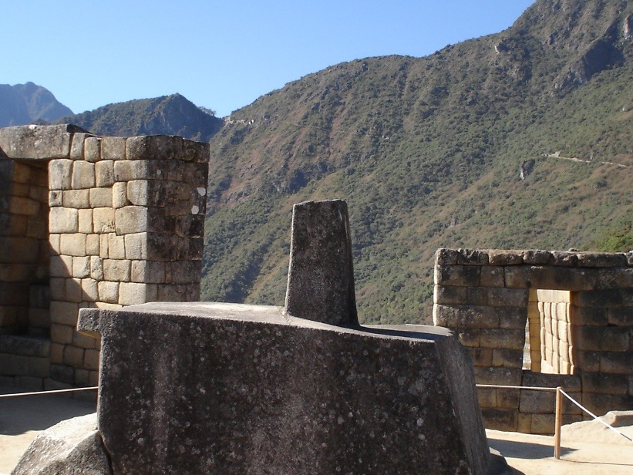
161. City of Machu Picchu. Central highlands, Peru. Inka.
c. 1450–1540 C.E. Granite
(architectural complex). (3 images)
Machu Picchu= Emperor’s Summer Home
Observatory
Intihuatana Stone

Slide 16
3400 Feet Above Sea level
From Cusco=
descends 970 ft to
The Summer Home
of the Incan
Emperor
2430 Feet
Miami is 6 Feet Above Sea Level

Slide 17
ATTRIBUTION:
Machu Picchu, Peru,
c. 1450–1540
Dry Stone Walls (like ashlar masonry= no use of mortar)
1) Sight lines to mountain tops=APUS
=Ancestral Deities= Makes Site Sacred
FORM: FUNCTION:
*Terraces Royal Estate= host feasts & sun
*Stone Buildings rituals
*Rock outcrops
CONTENT: CONTEXT:
ART CHARACTERISTICS
1)
2)
3)
4)

Slide 18
Site Built as a royal estate for the First Inka Emperor Pachacuti Inka Yupanqui after a Successful Military Campaign
CONTENT:
1) On a mountain saddle overlooking the Urubamba River
2)Three days walk from City of Cusco
3)3,000 feet lower in elevation
4)Site was chosen for its relationship to the Andean landscape, including sight lines to other mountain peaks, called APUS=Ancestral Deities throughout the Andes
FUNCTION:
Intended as place for the emperor to hold feasts, perform religious ceremonies, and administer the affairs of the empire
Contains housing for elites, retainers and religious staff, religious shrines, fountains, and terraces, and carved rocky outcrops
Socially Stratified=Divided by CLASS

Slide 19
Machu Pichu Abandoned After 80 Years
C
O
N
T
E
X
T
All houses and terraces are built by carefully fitting individual blocks against each other
Like the wall in City of Cusco
Outward walls were smoothed, like the Golden House
TERRACES =Increase arable land surface and reduce erosion by creating walled steps down
Provided Food for the emperor and entourage during his visits, and producing ritually-important maize crops
Water management was crucial
1)System of stone channels that channeled rain and spring water into 16 stone fountains
2)May have been a ritual bath for the emperor, connected to his duties as a sacred king
2,430 meters (7,970 feet)
Socially Stratified
=Divided by CLASS

Slide 20
REMEMBER THE TWO TYPES OF QUESTIONS ON THE 2020 EXAM KEEP THIS IN MIND AS YOU LEARN NEW ART WORKS
25-Minute Long Essay Response
Focus on Comparison of Theme
Ritual, Power & Authority
Gender, Depiction of Human Form, Sacred Space & Object
Landscape , Man’s Relationship with Nature
15 Minute Short Essay
Response
Focus on
Continuity & Change
How art reflects & deviates from Tradition?

Slide 21
Observatory & Temple of the Sun= GRANITE *Adjacent to the royal residence *Emphasized the relationship between the elites, ritual performance, and astronomical observations *Solidified Emperors as Descendent of the Sun
Two Main Parts:
1) Upper Curved Stone Enclosure with windows and niches = Observe Sun’s Movement & Fertility Rituals
2) CAVE beneath the structure with masonry additions that hold more niches
SACRED RITUAL SPACE
=refer to the place of the underworld in Inka myth= Womb of Mother Earth
Embodies cosmological thought and astronomical observation
Showcases Royal Family Job of solidifying Good relationship with the gods

Slide 22
Intihuatana Stone “The hitching post of the sun” Determines TIME-Sun Dial GRANITE
Carved boulder located in the ritual area of the site, to the west of the main plaza
1) Symbolizes relationship with the earth
2) Expressions of belief in a landscape inhabited by supernatural forces
3) Stone’s name refers to the idea that it was used to track the passage of the sun throughout the year

Slide 23
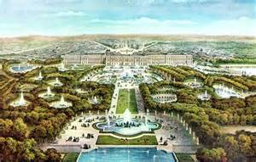
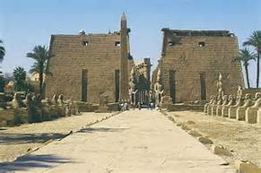
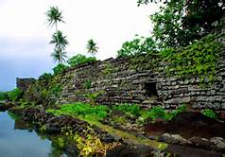
Theme= Power & Authority, Ritual, Domestic Space Similar Art History Structures
VERSAILLES=Social Stratification & Sun Images
TEMPLE OF AMUN RA=
Ritual & Sun God & Ties Leaders to Deities
NAN MADOL=Social Stratification

Slide 24
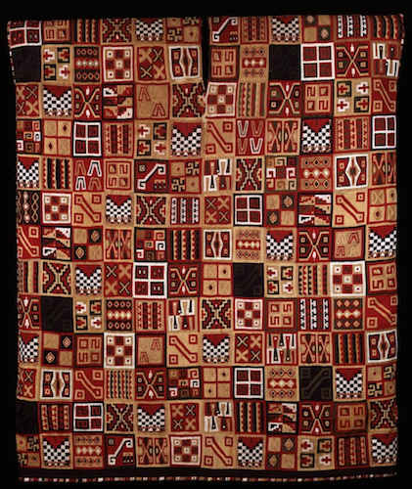
ATTRIBUTION:
All-T’oqapu Tunic,
Inka, 1450–1540,
camelid fiber and cotton,
90.2 x 77.15 cm
2)
FORM: FUNCTION:
*Geometric Designs * Poncho for Elite
*Dyed Animal & Plant Fibers
*Colorful Dyes
*Red & Blue Most Prized
*Large Rectangular Tunic =Power
CONTENT: CONTEXT:
ART CHARACTERISTICS
1)
2)
3)
4)
3)

Slide 25
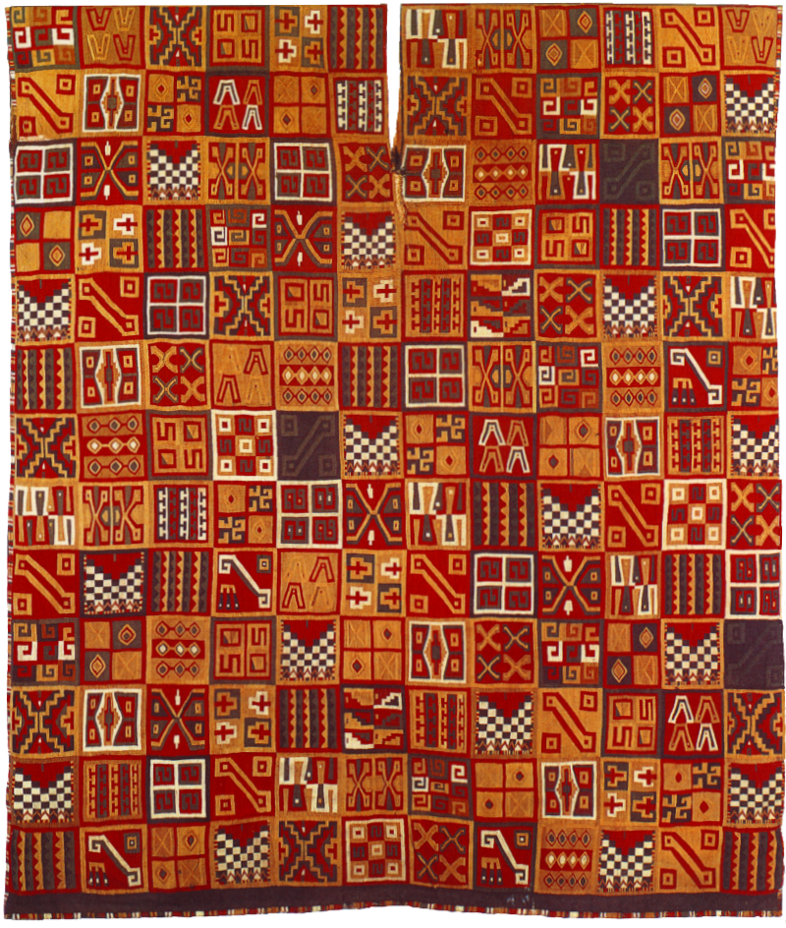
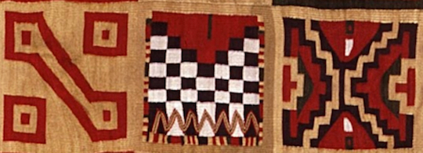
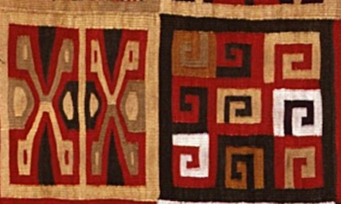
CONTENT:
Power & Authority and Wealth & Status
Slits for Head & Arms
Textiles were given as royal gifts, worn by the royal household, or burned in a precious sacrifice to the sun god, Inti
Approximately 1,000 threads per square inch
Traditional to weave in a single piece if possible, cutting the cloth from the loom would destroy its spirit existence which formed as it grew on the loom
Name comes from the decoration of the tunic
T’oqapu are the square geometric motifs
=Red & Blue Fibers Most Prized
Motifs were only allowed to be worn by those of high rank in Inka society
Individual designs showcase Elite Status
Individual t’oqapu designs are believed to represent various peoples/ethnicities, places, and social roles within the Inka empire
The collection of many patterns shows that the Sapa Inka owner of the Poncho (which means “unique Inka” in Quechua) was a special individual

Slide 26
CONTEXT:
Trade and exchange of high-status goods were used to secure reciprocal but unequal economic and power relationships between the Inka and their subjects
Political feasts and finely-woven textiles would cement unequal relationships
Weaving in Andean cultures was done on a loom made from a series of sturdy sticks
Loom is tied to a tree or post at one end and the other is attached to a strap that goes around the back of the weaver
By leaning back, the weaver can adjust the tension of the threads, creating the surface pattern
A lot of variations by the time the Inka came to power
Two main fibers used are cotton and camelid
Cotton plants grew well and camelids thrived
Animal fibers are more easily dyed=like Llamas/Alpacas
Collecting, spinning, and dyeing fibers was a long process
Special Holy Woman ( acllas ) wove the tunic and only Royal or Elites could wear it & performed rituals
LIKE THE PEPLOS MADE FOR ATHENA F0R THE
PARTHENON PROCESSION
Or the HAWAIAN AHU ‘ULA

Slide 27
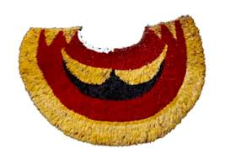
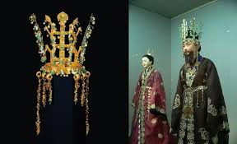
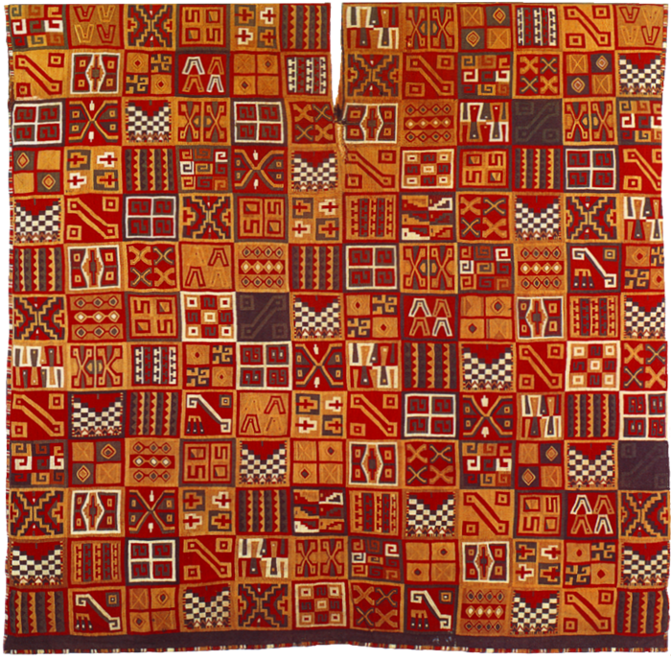
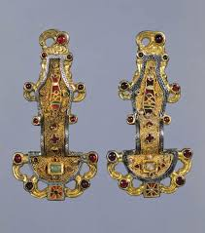
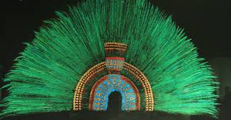
Theme: Wearable art illustrating status & Wealth

