Slide 1
Byzantine Collage & Architecture Essay Pre-Writing

Slide 2
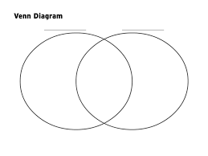
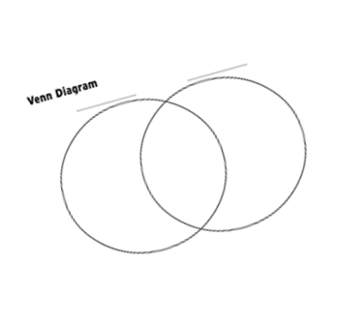
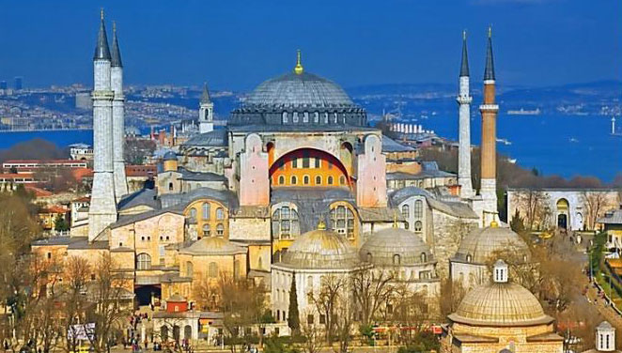
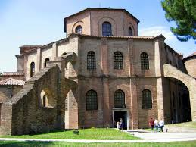
IN A DETAILED VENN DIAGRAM OUTLINE THE DIFFERENCES & SIMILARITIES Hagia Sophia and San Vitale
Include:
Location
Architecture Features
Interior
Important Art Pieces
LAYOUT**
Patron & Religion
Size
Shape
Window & Entrances
Political & Historical Details
Original & Present Day Usage

Slide 3
Collage & Art Identification Create a collage with IMAGES of the Hagia Sophia & San Vitale Divide the paper in half and label the two sides with Title and Identification Elements & Images
IMAGES Include:
Exterior
Interior
Artwork
Layout/
Ground Plan
Minimum of 5 images per Building
IDENTIFICATION Includes:
Title
Country of Origin
Culture
Years of Construction
Materials/Medium

