Slide 1
APAH Exam Review= 26 Difficult Works

Slide 2
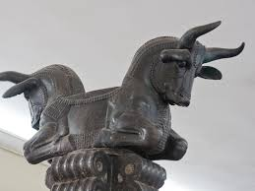
Apādana/Audience Hall Persepolis (Fars, Iran), c. 520-465 B.C.E
*PERSIAN
*POWER & AUTHORITY/INTIMIDATION
= HUGE SIZE
=LION EATING GAZELLE
=ARMY
*TAXES & TRIBUTE BROUGHT
TO NEW YEARS FESTIVAL
*DUAL BULL CAPITALS= POWER
*TREASURY

Slide 3
"Plaque of the Ergastines," 445 - 438 B.C.E., Pentelic marble (Attica), 0.96 x 2.07 m, fragment from the frieze on the east side of the Parthenon
*Frieze on the exterior of Parthenon
*Drapery& Realistic Human Form
*Contrapposto
*Celebrates Panathenaic Procession
*Depicts new Peplos delivery
for Statue of Athena OR
*Sacrifice of Greek King of
daughters to save Athens

Slide 4
Vienna Genesis, early 6th century, tempera, gold and silver on purple vellum Rebecca and Eliezer at the Well
Illuminated Manuscript
Old Testament 1st Book
Continuous Narrative
Syncretism=
Christian abstraction
& Roman REALISM & imagery
Purple- Power & Status & Wealth

Slide 5
Vienna Genesis, early 6th century, tempera, gold and silver on purple vellum Jacob Wrestling the Angel Renamed “Israel”

Slide 6
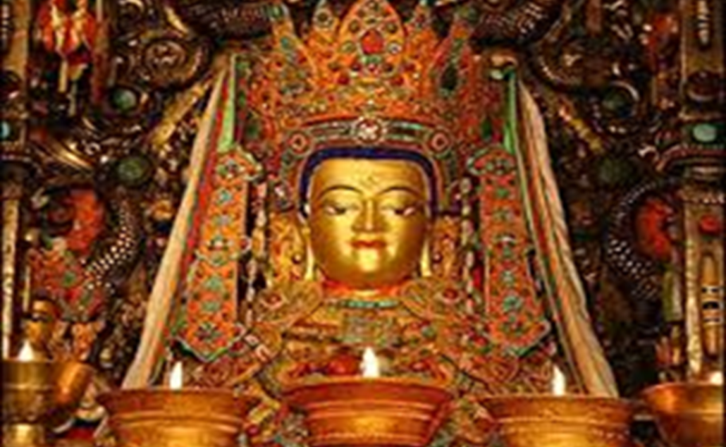
Jowo Rinpoche Jokhang Temple, Lhasa, Tibet, brought to Tibet in 641 gilt metals with semiprecious stones, pearls, and paint
Child Buddha
Limited Access by Communist Government
Transformed by Pilgrims donation of Gold & Gems
Beheaded/Vandalized in 60’s= Reunited in the 80’s
Jo= Lord
Rinpoche=Precious One

Slide 7
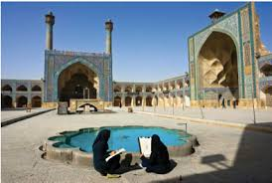
The Great Mosque or Masjid-e Jameh of Isfahan 8th through the 20th centuries
Transformed by Dome
Tessellation & Arabesque &
Pointed Arches
Working & Urban Mosque
=(2) Minarets
Water Feature- Purification

Slide 8
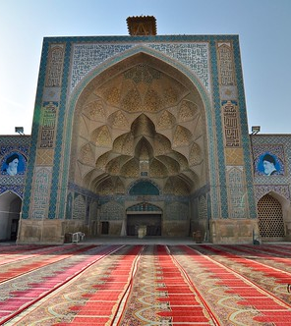
MuQarnas Complex & Innovative large number of miniature squinches, producing a sort of cellular structure", sometimes also called a "honeycomb" vault.

Slide 9
Lakshmana temple, Khajuraho, India, dedicated 954 C.E. (Chandella period), sandstone
Elevated Hindu Sacred Space
Resembles Mt. Mehru
Erotic Temple= Sex metaphor for Regeneration
Lizard Shaped Ground Map
Inner Womb Room (Tiny) &
6 Towers

Slide 10
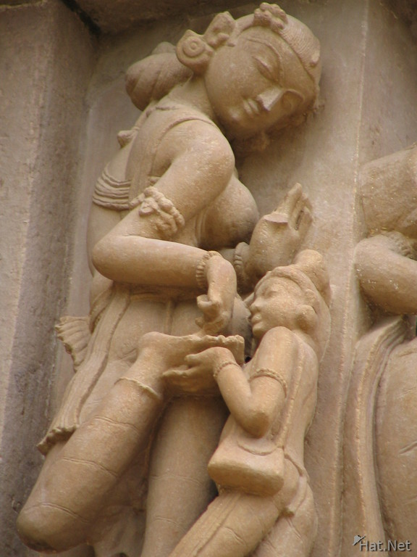
Covered with high Reliefs of 600 Hindu Gods & Idealized Depictions of Females= Auspicious & Protective & A Blessing

Slide 11
Lakshama Patronage “Lion” Sculpture * Power * Wealth & Status * Built Temple as Gift to Vishnu Warrior defeating Lion ( Rounded Construction= reincarnation)

Slide 12
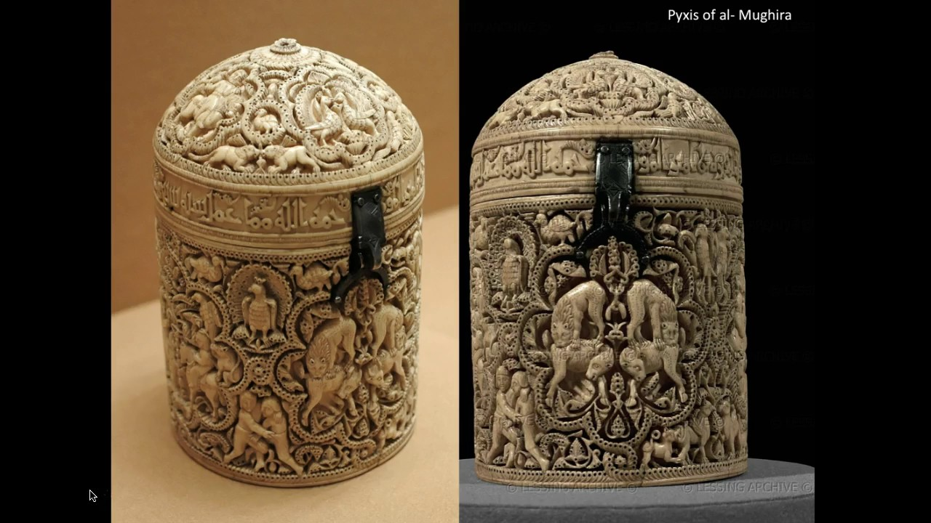
Pyxis of al-Mughira,
possibly from Madinat al-Zahra,
968 CE,
carved ivory with traces of jade
Air Freshener
Royal luxury item
Medallion= male hobbies
Horror Vaculi
Propaganda= Validating Power
Legitimacy of Umayyad Caliphs
Over Abassid Caliphs
Inscription= name of owner,
blessings & function

Slide 13
Bayeux Tapestry 1070, embroidered wool on linen, REGISTERS Of Text & Imagery of Norman Invasion of England
*BISHOP OTTO=
BROTHER
WILLIAM
CONQUEROR
*PEP
RALLY DINER
*HISTORICAL
DOCUMENT

Slide 14
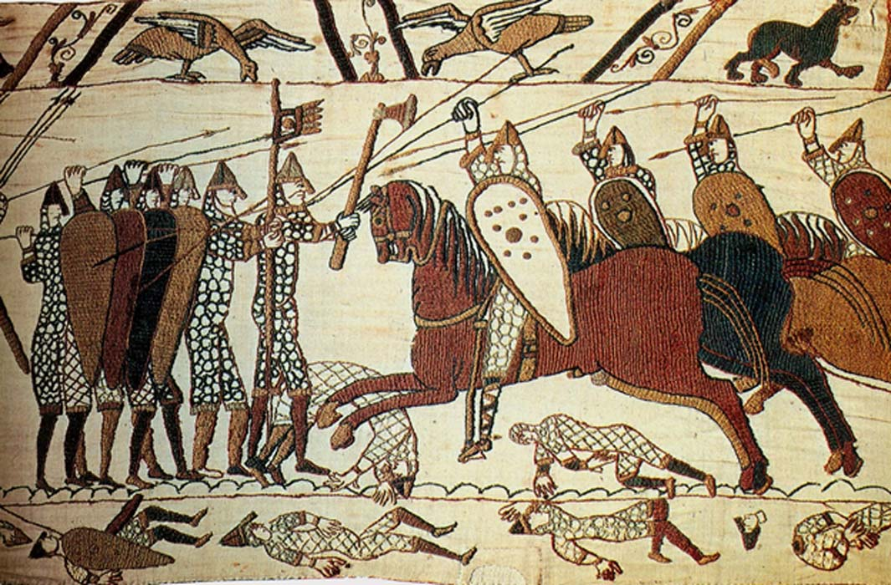
*Banquet & Battle Scenes
*Calvary Attack

Slide 15
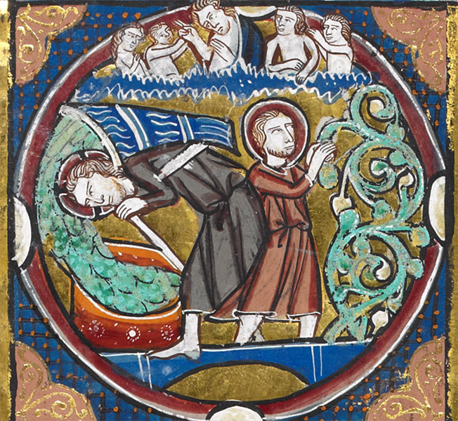
Bible Moralisee -Scenes from the Apocalypse Illuminated Manuscript=vellum France, c. 1225-45 (13th century)
Last Judgement= Apocalypse ( End Times)
Good & Evil Battle
Illustration & Biblical Text with Commentary
*God & Angels
*Vineyard
*Christ pouring
wine= sacrifice

Slide 16
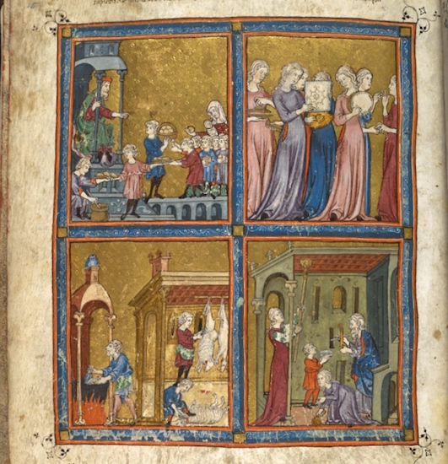
Golden Haggadah
c. 1320, northern Spain, VELLUM
Haggadah=Narration
-Passover Preparation
Fulfulment of Commandment
To Retell Story of Jewish
Liberation from Slavery
Registers
Illustrates Prep for Passover
Charity, Music, Food, & Cleansing /
Purifying from Leaven Bread
Looks like Stain Glass
Syncretism
French Gothic Style & Judaic Ideas

Slide 17
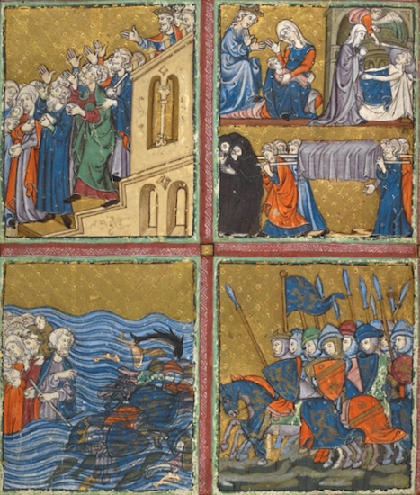
Golden Haggadah
c. 1320, northern Spain,
VELLUM & Gold & Pigment
READ AT PASSOVER SEDAR
Plague & Death of First Born
Pharaoh orders Israelites to Leave
Egyptian in Medieval Armor
attack Israelites
e) Parting of the Red Sea
= Egyptian Drowns

Slide 18
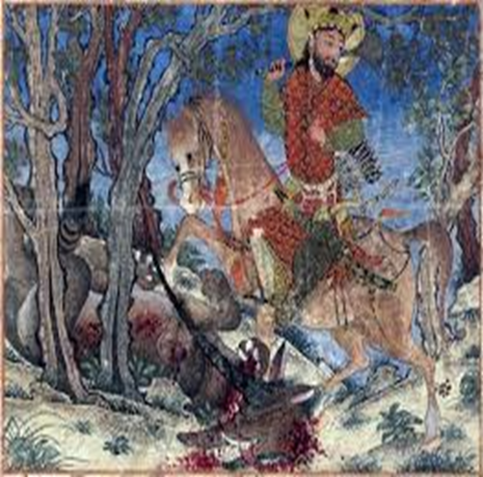
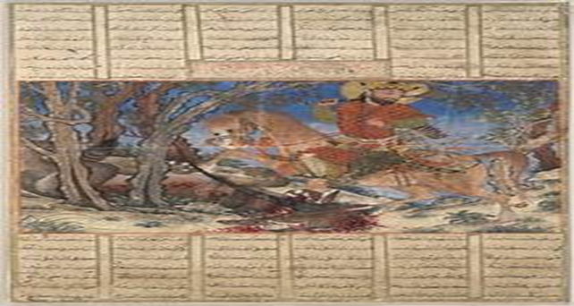
Bahram Gur Fights the Karg (Horned Wolf), from the Great Mongol Shahnama, c. 1330-40, Iran, ink, colors, gold, and silver on paper, folio 41.5 x 30 cm
National Epic Hero=Iran
Cultural Identity
Power & Authority= on horse, richly dressed & over dead karg
Illustrates the text
Syncretism= Chinese Landscape, Persian Story & European Robe

Slide 19
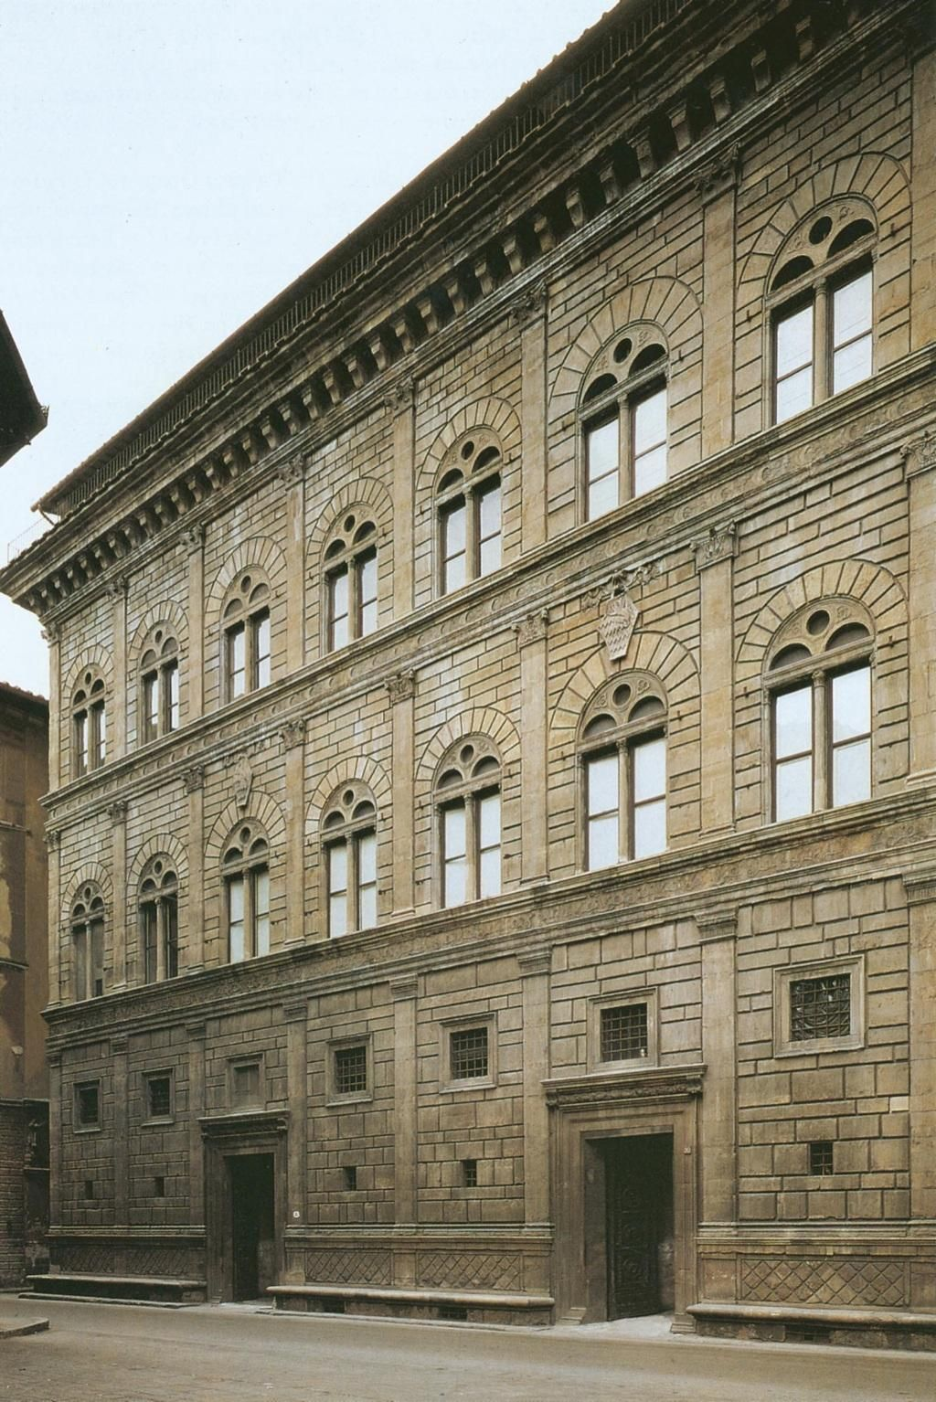
Leon Battista Alberti, Palazzo Rucellai. Florence, c. 1446-51
Humanist Renaissance
architecture for a Private Home
Power & Wealth
Looks like Coliseum
Entablature, Arches & Capitals
Doric, Ionic & Corinthian
Wrapped by Benches = Hospitality

Slide 20
Sultan Muhammad, The Court of Gayumars, c.1522, 47 x 32 cm, opaque watercolor, ink, gold, silver on paper, folio Shahnama
Status & Wealth
Kingship & Heroes
Cultural Identity
1st king of Persia
Hierarchy of scale, Blue pigment *
Gold
Chinese Tree= Syncretism

Slide 21
The Ardabil Carpet Medallion Carpet Persian: Safavid Dynasty, silk warps and wefts with wool pile (25 million knots, 340 per sq. inch), 1539-40
Oldest Rug in World
Woven By 10 People
Not Symmetrical to Honor God
Persian Traditional Craft
Prayer Rug
Huge-=Honor Dead = Funerary
Mosque Pendant Lamps
Dome
The Ardabil Carpet

Slide 22
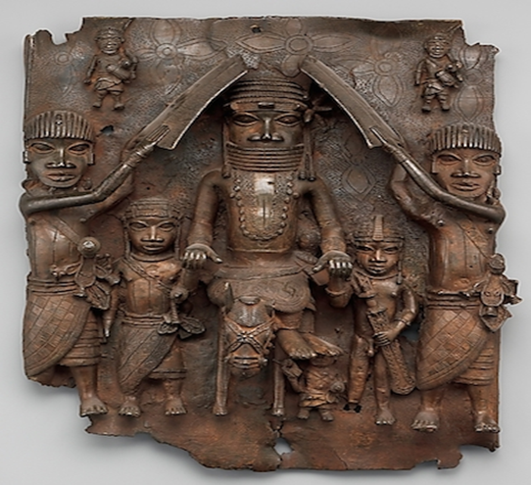
Benin Plaque: Equestrian Oba and Attendants 1550–1680- brass
Complex Knowledge of Metallurgy
Decorated Walls of Palace= Speaks to Conduct
= Historic Narrative & Power & Authority
Lost Wax Process = High Relief= 3-D
Only the King/Oba could be shielded
= Status, Wealth & Power
=Hierarchy of Scale & On Horse
=Stepping on Enemy
Oba= Coral beaded Regalia &
Surrounded by Court
Cross Cultural= Reflects Trade with the
Portuguese= flowers & crosses

Slide 23
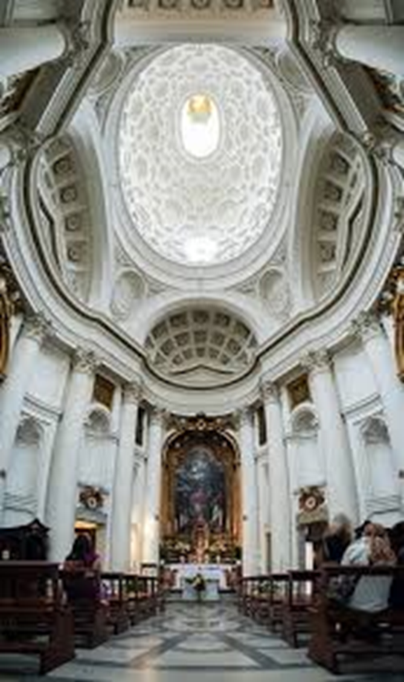
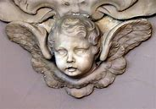
Francesco Borromini, San Carlo alle Quattro Fontane Rome 1638-1646- bAroque
Undulations= Movement= fluid
Dramatic= height, light & white
Fits into Urban Tight Space
Hidden light source
Oculus/ Holy Spirit/ Cherubs/No aisle= closer to altar

Slide 24
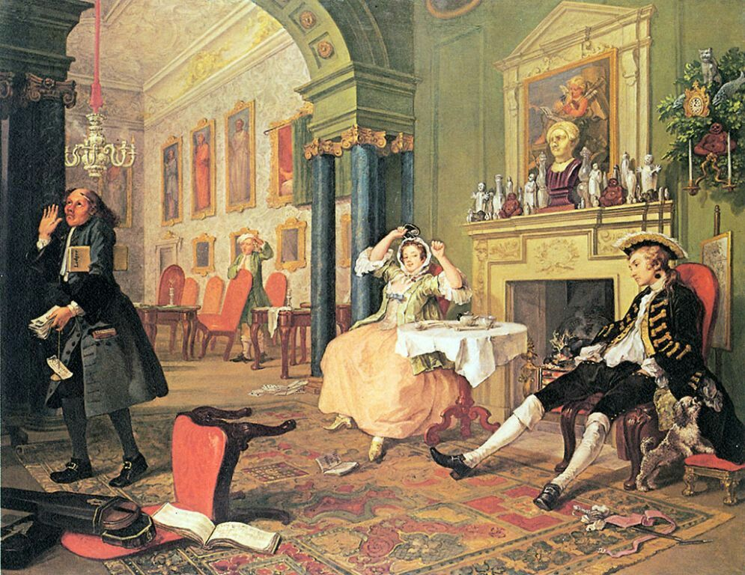
Marriage A-la-Mode: The Tête à Tête 1743, William Hogarth oil on Canvas
Satirical & Mocking of Aristocratic Marriage
Model for Engravings
Invented Political cartoon

Slide 25
Ogata Kōrin, Red and White Plum Blossoms, Edo period, 18th century, pair of two-fold screens, color and gold leaf on paper,
Minimalist
Asymmetrical
Reductive
Abstract
Contrast
White= Buds/Pink = Flowers
RinPa School
Folding Screen

Slide 26
Käthe Kollwitz, Memorial Sheet of Karl Liebknecht (1919-1920, Woodcut heightened with white and black ink, 37.1 × 51.9 cm
*Woodcut Print in responses to Liebknect death in Spartacus Revolt=Communist Uprising in German
*Primitive, Mask –Like & Linear
*German- Expressionism

Slide 27
Veranda Post Of Enthroned King & Senior Wife before 1938 (Yoruba people, Nigeria), wood & pigment
Opo Ogoga
(1) of (4)=Dependence on King on Others
Interrelation of Characters, Exaggerated Proportions & Negative Space
Power & Wealth
King= lowered gaze, on throne& heavy crown ( kingship)
Senior Queen- standing, hands on throne & large scale= places crown at investiture
Kneeling woman, flute –playing trickster god Esu & fan bearer= subservience & divine right

Slide 28
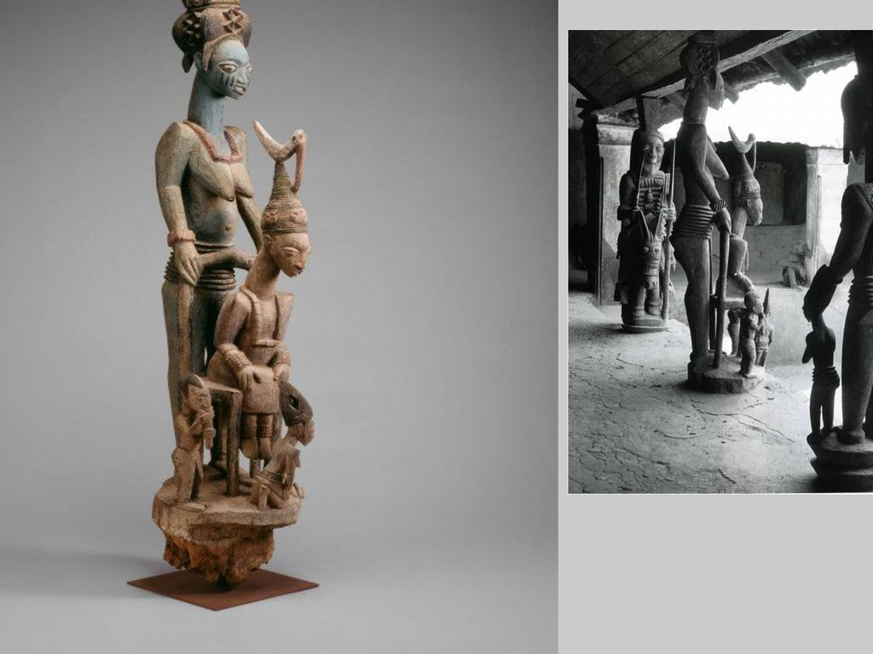
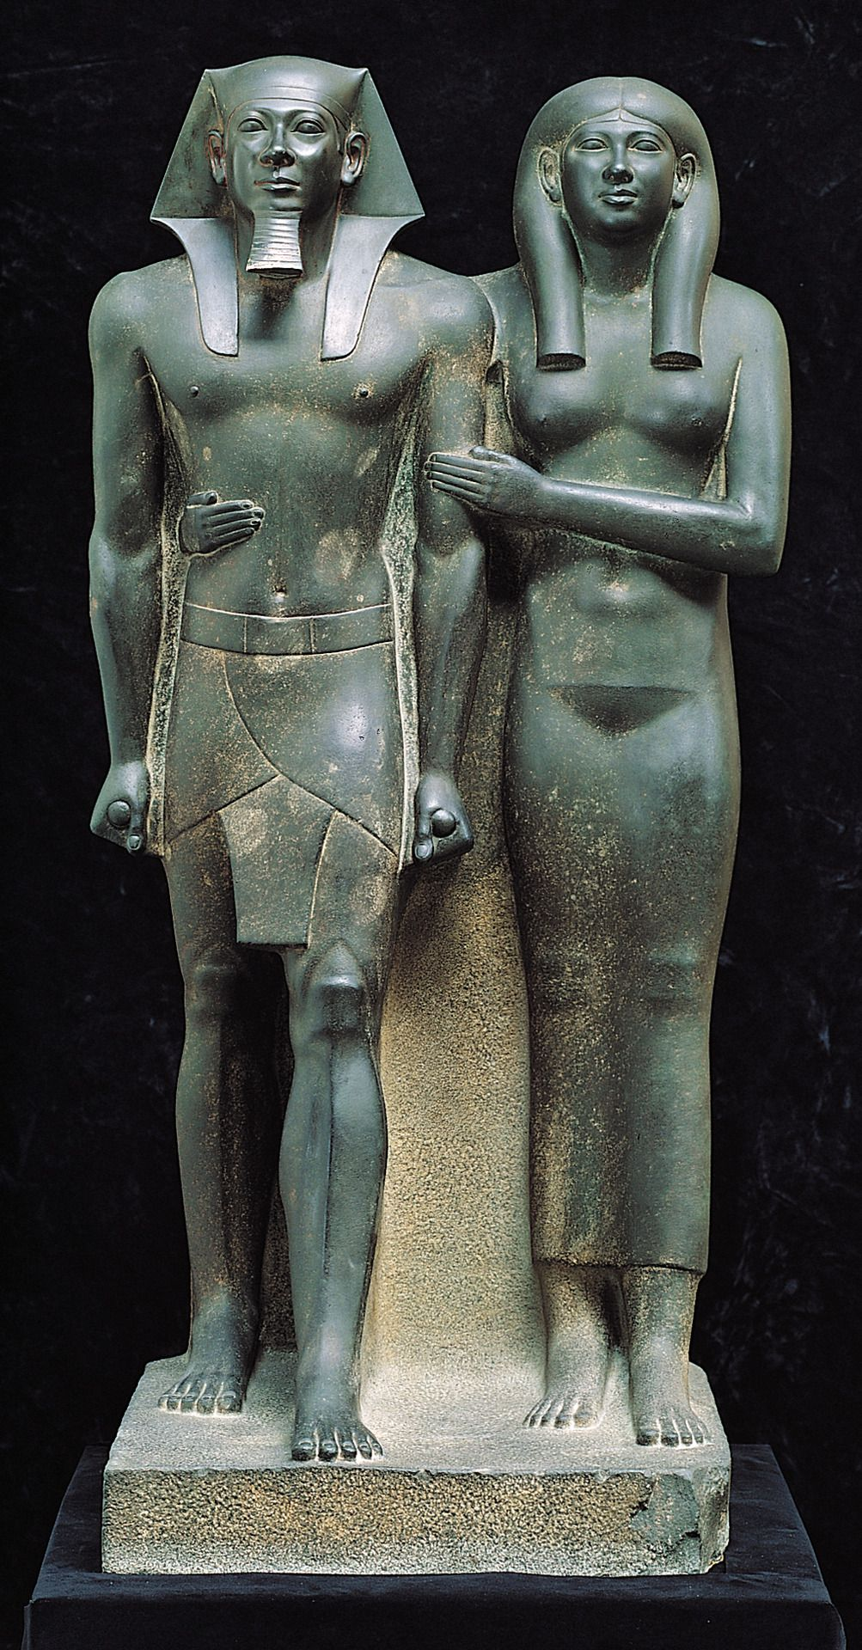
Royal Couples Wife support Crown

Slide 29
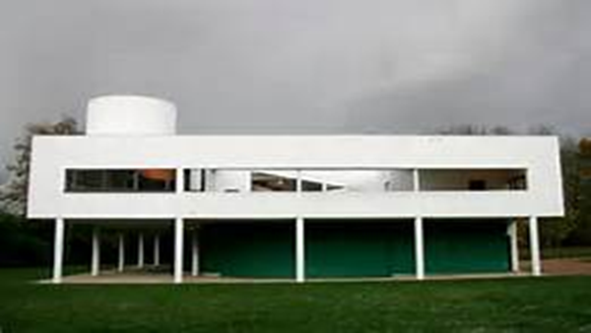
Le Corbusier, Villa Savoye, Poissy, France, 1929
Modern Art as Architecture
Reductive
Minimalism & Geometric
Illusion of floating= Pilotis
Rejects Tradition

Slide 30
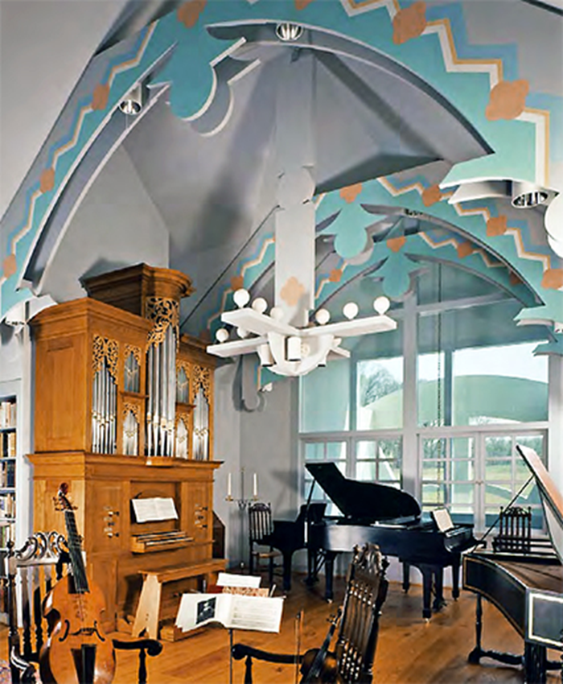
Robert Venturi, John Rauch, and Denise Scott Brown, House in New Castle County, Delaware, 1978-83
Post Modern
Uses Historical Elements in Decorative & Whimsical Manner
Built to reflect Patrons Hobbies

Slide 31
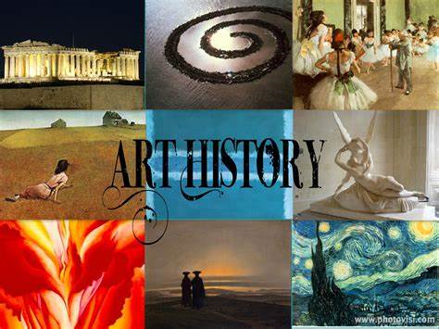
APAH EXAM PREP

Slide 32
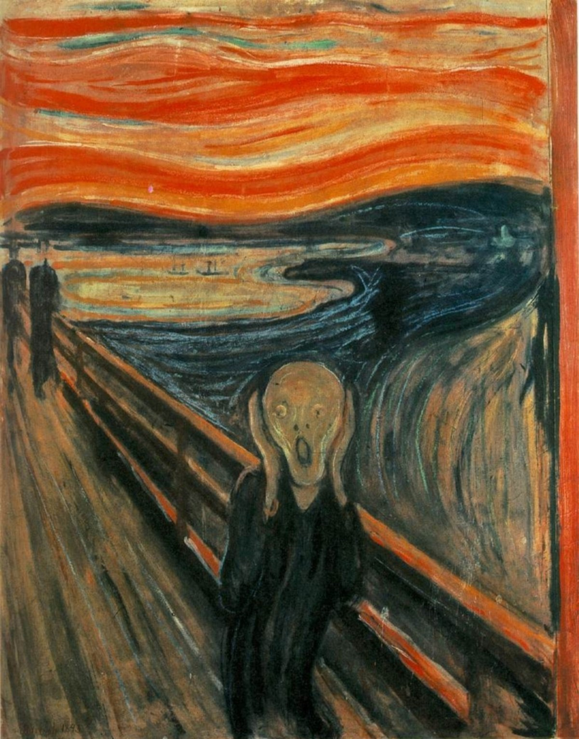
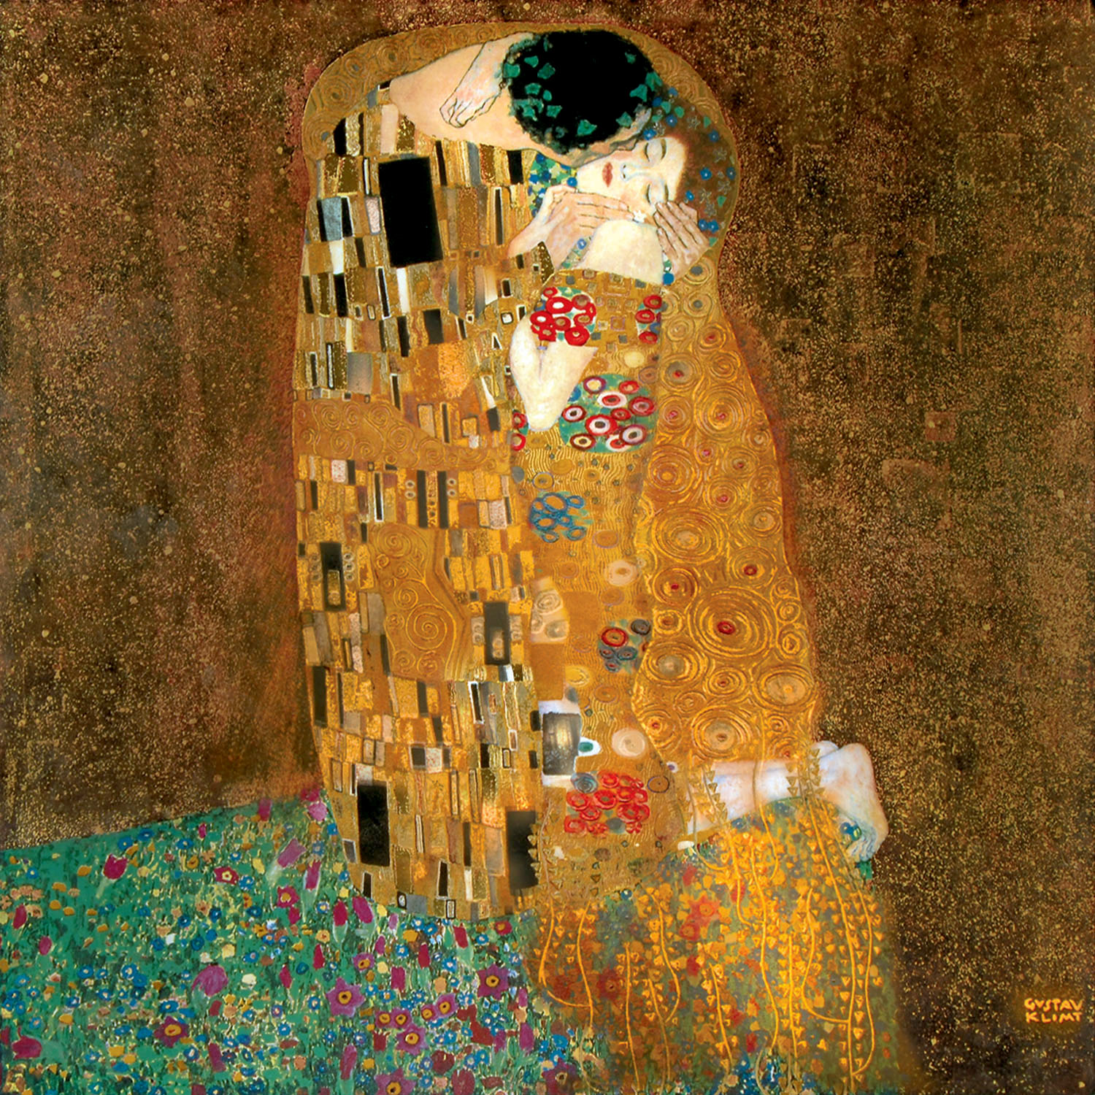
22-29
Left Image
Right Image

Slide 33
Identify the works by title, artist and medium
How does each artist demonstrate influence from other artistic traditions and artists?
How is each work Symbolist?
A.
B.

Slide 34
1) a-Gustav Klimt, The Kiss,oil and gold leaf on canvas B-edvard Munch, The Scream, tempera on board
3)
A-Psychological= Panic/ Fear/ Anxiety & Distorted
B-Psychological= Bliss & Love & Distorted & Reductive
2)
A-Van Gogh & Gauguin
B-San Vital & Byzantine Icons

Slide 35
SCORING
10-A
9-8=B
7-6=C
5-4=D

Slide 36
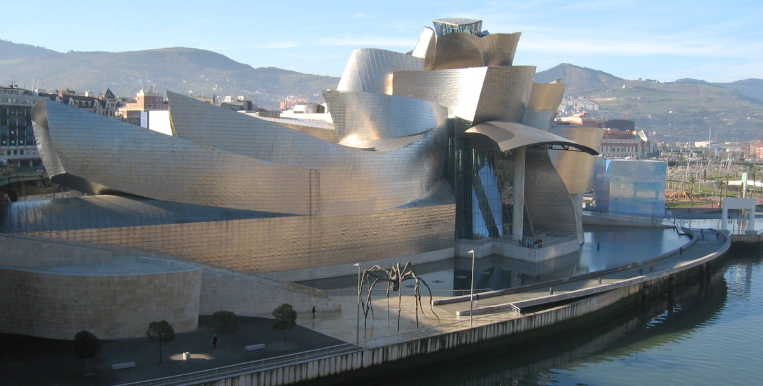
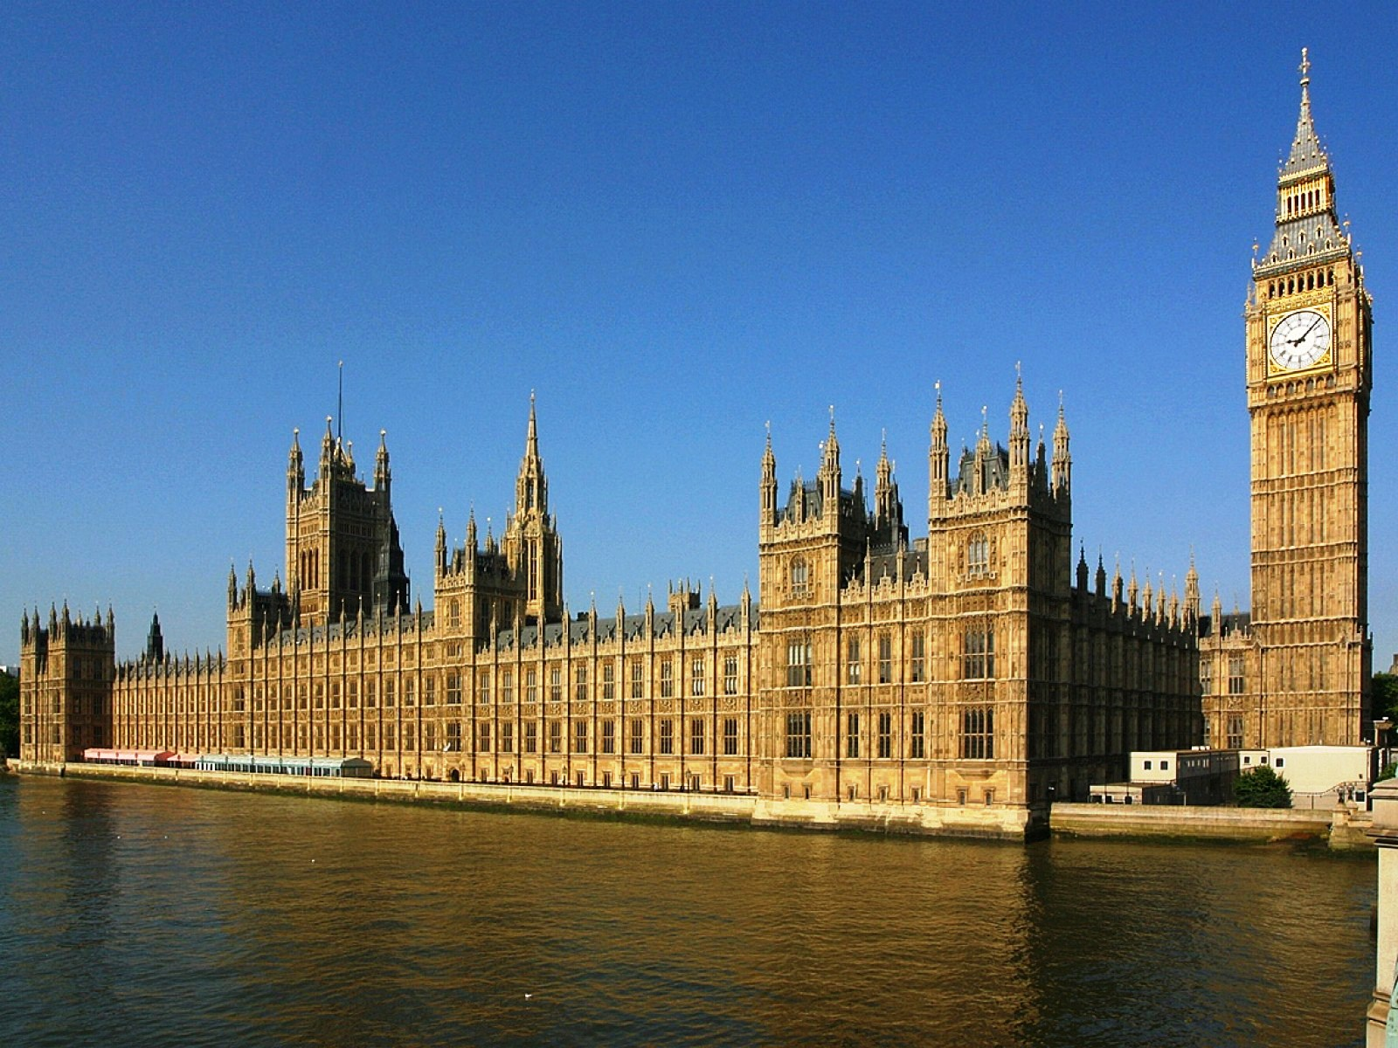
Identify the works by title, architect and art movement
How does each structure reflect innovation?
A)
B)

Slide 37
1. a) Guggenheim Museum Bilbao, Frank Gehry= Post Modernism B) Palace of Westminster (Houses of Parliament), Charles Barry, A.W.N. Pugin =neo-Gothic
2) Innovation=
Curvilinear & Reductive
Created w/ computer assistance
Titanium
Post-Modern= History- Fishing Village
2) Innovation=
Steel
Neo-Gothic
Not Neo- Classical
Result of a Contest

Slide 38
SCORING
10-A
9-8=B
7-6=C
5-4=D

Slide 39
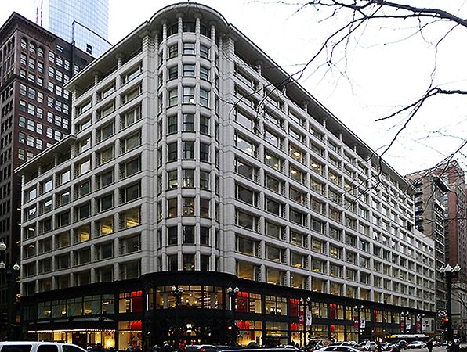
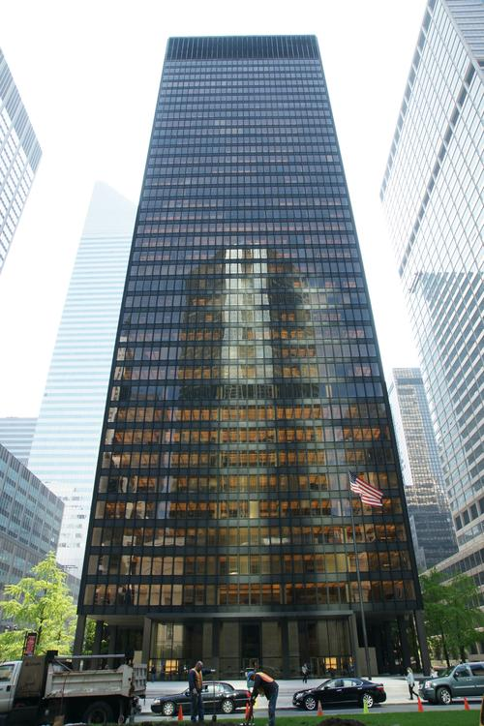
1)Id the buildings and their function
ID= Title, Architect, Medium & Movement
2)Explain which building looks historical and which looks progressive
Why?
A)
B)

Slide 40
ID= Title, Architect, Medium & Culture
Carson, Pirie, Scott and Company Building
Louis Sullivan
Terra-Cotta, Steel, Cast Iron & Glass
Art Nouveau
Window Shopping/Beautify City/ Commercial/Economic

Slide 41
ID= Title, Architect, Medium & Culture
Seagram Building
Ludwig Mies Van Der Roche
Phillip Johnson
Glass & Steel & Bronze
Modernism/ International Style
Space Allocation- Verticality= Small Urban Space
Space/Economic= Financial Engine

Slide 42
Explain which building looks historical and which looks progressive
Historic
Carson, Pirie, Scott and Company Building
Material= Terra-Cotta/Cast Iron
Ornamentation= Flowers/Vines
Art Nouveau=Make Pretty
Entabulatures
Progressive
Seagram Building
Materials=Steel & Glass
Minimalist/Geometric/
Reductive
Form Following Function

Slide 43
SCORING
14-A
13-12=B
10-11=C
9-7=D

