Slide 1
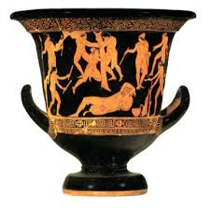
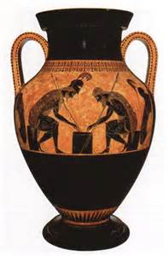
APAH – Greek Vase Art

Slide 2
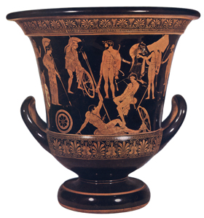
Niobid Krater
Museum: Paris, Louvre
Found in Orvieto Italy Size: 55cm. (calyx-crater) Function: mixing bowl for water & wine
Technique: red-figure with variable ground lines and landscape elements
& white highlights Style: early classical Subject/s: A. Herakles and Athena join Greek heroes.
B. Apollo and Artemis avenge their mother by slaughtering the
slaughtering the children of Niobe who boasted superiority Date: 460-450 bce- mid 5th century.
Medium : Clay
Analysis:
*most famous example in Athenian vase-painting of the use of variable ground lines, landscape features such as hills, painted in white, and trees in red-figure, partially hidden figures and three-quartered and frontal faces.
*painted not long after the wall painter Polygnotos was brought from Thasos to work at Delphi and Athens,+Temple at Delphi.== influenced wall painting
* first time that isocephalism was used
* isocephalism = depicting heads of figures on the same level
*showcases the innovative technique of the now lost mural paintings of Polygnotus, another Greek painter of the 5th century bc.

Slide 3
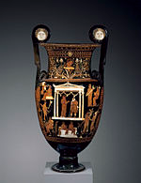
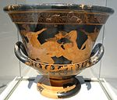
KRATERS=BIG MIXING BOWLS
Drinking ákratos (undiluted) wine was considered a severe faux pas in ancient Greece, enough to characterize the drinker as a drunkard and someone who lacked restraint and principle.
Kraters were used to hold the mixture

Slide 4
Decorative Border=Meander
LIP
Handles
Decorative Border=Meander
FOOT

Slide 5
Art Elements Red –Figure Pottery
The Niobid Painter has arranged his figures so that they are set on different levels, suggesting different ground lines by means of a fine, painted white line.
Landscape setting, too, is suggested:
Athena and Heracles appear to be standing on a hilly terrain= Forest of Mt. Sisylos
Apparently, the Niobid Painter made a deliberate attempt to express space and depth.
Shorthand to Suggest a Myth or Narrative

Slide 6
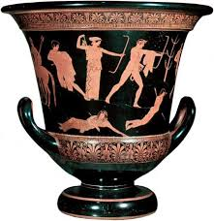
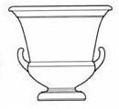
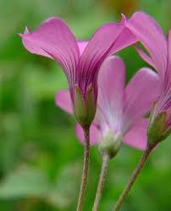
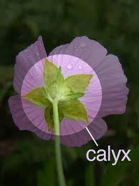
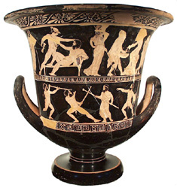
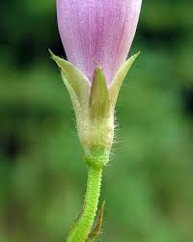
Calyx- Krater
CALYX:
A natural flower shape
KRATER:
The handles of the calyx-krater
are placed low down on the body
of the vase
It continues to be produced, mainly in red-figure, becoming more elongated over the course of the fifth and fourth centuries

Slide 7
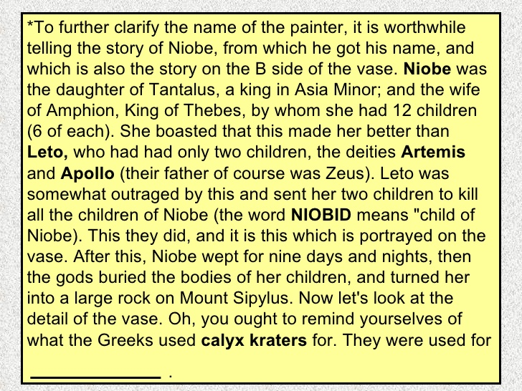

Slide 8
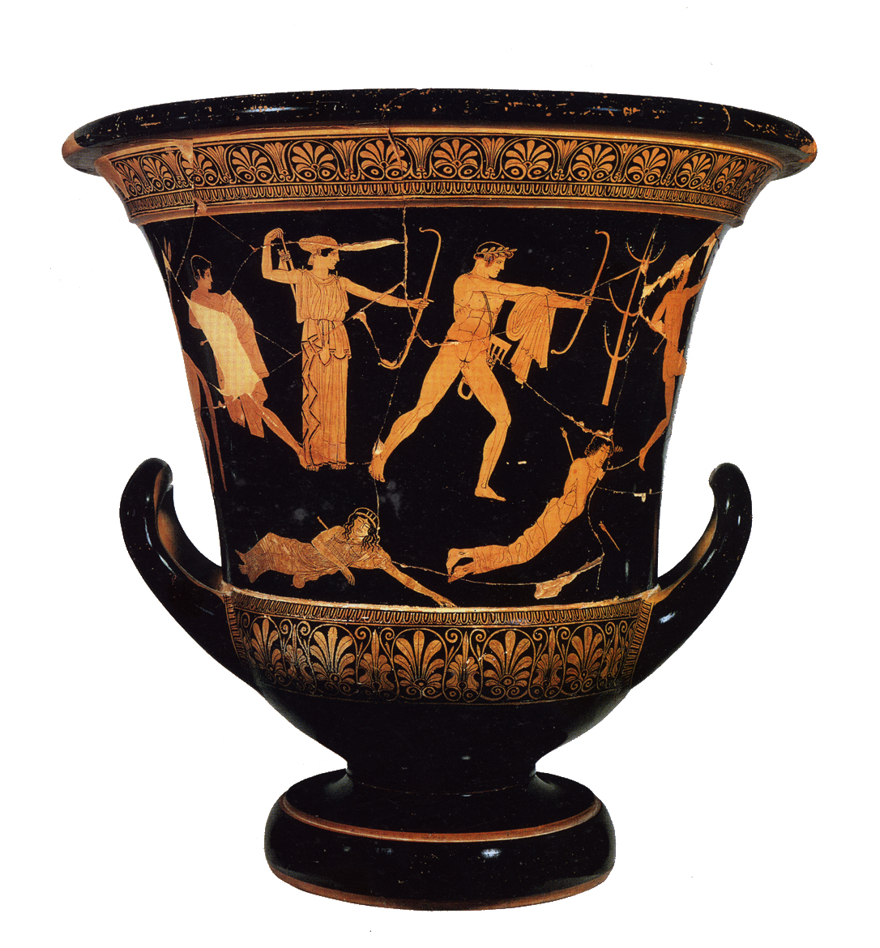
Artemis and Apollo with bow & arrows
Tree=
First Attempt
at
Landscape &
Naked Youth
Running
to avoid death
Hiding
in a cloak
to escape
death
Niobe’s dead children

Slide 9
Athena=wisdom
Aegis=goatskin
with a gorgon clasp
Herakles=lion skin & club
Frontal body & face profile
Soldier= helmet/ spear
& shield
Naked Youths
Reclining Naked
Youth= ¾ face

Slide 10
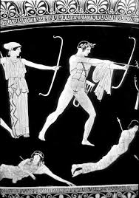

Slide 11
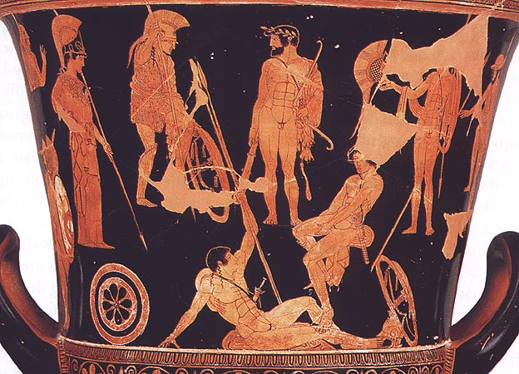

Slide 12
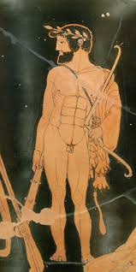

Slide 13
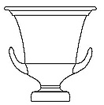
Vase can be DRAWN as the first step
CUT OUT as the last step
1) Draw the shape= Krater
1) Color the shape using the pencils in browns, yellows and reds
2) Color this with a black crayon
3) Etch using a pen or pencil a traditional design
( use the book, handout and internet)

